Slide 1
Get started with Microsoft 365 Copilot in PowerPoint
Practical examples and how-tos

Slide 2

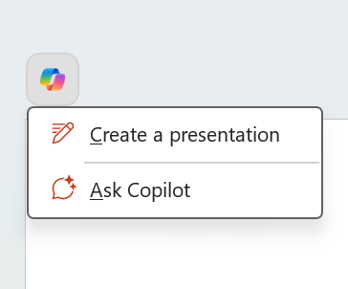
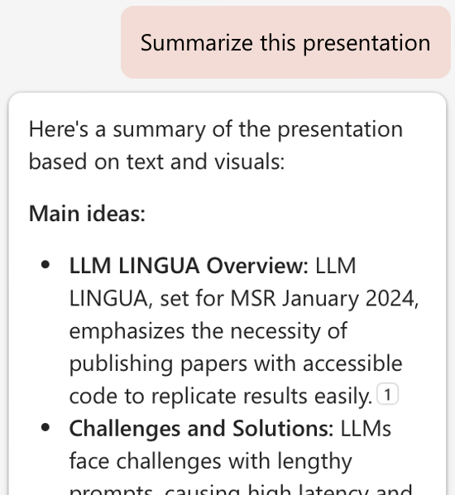
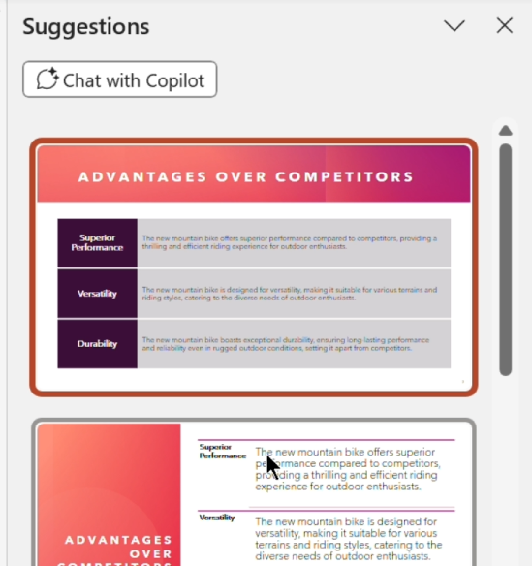
Copilot in PowerPoint overview
Create
Summarize and understand
Organize and edit
Start from a template with your corporate brand and Create a presentation from a prompt, grounded on a /file (Word/PDF document).
Summarize this presentation.
What are the key slides?
Have Copilot organize my presentation.
Quickly change an image.
Use Designer to update a slide layout.
Notes:
The slide introduces "Microsoft PowerPoint Get Started with Copilot" and highlights its features. It includes the Microsoft logo, the main title, and a subtitle "Feature Highlights." The slide also displays a futuristic design of a PowerPoint presentation interface with various labels indicating different features.

Slide 3
Create
Create a new presentation with your corporate template using Copilot and add a topic based on a Microsoft Word document
Notes:
Open your company template or an existing deck and use Copilot to create new, branded PowerPoint presentation based on a Word document.

Slide 4
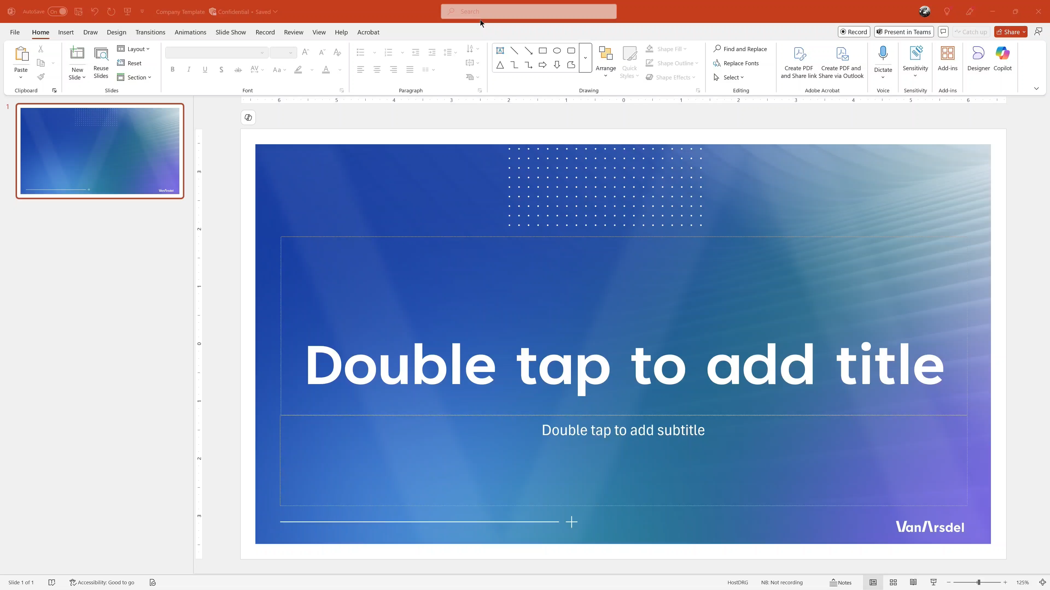
Creating a new presentation (video)
Notes:
[Video]
00:00 - I need to create a new presentation for a new service our firm is offering.
00:05 - I'm going to start with our corporate template and ask Copilot to create an entire deck as a starting point.
00:17 - Copilot creates a set of topics that I can edit and reorder as I like.
00:20 - I can also add a new topic and direct Copilot to refer to one of my project documents that includes details of customer testimonials.
00:27 - I can add more topics if I'd like, honing my presentation along the way.
00:31 - Once I am happy with my topics, I can click Generate Slides to build my presentation.
00:39 - Copilot creates a complete presentation.
00:42 - It adds slide titles, body content, appropriate images, and even writes draft speaker notes for me.
00:51 - And now I have this fantastic start to my presentation, and I can focus on polishing my story, saving me hours of work.
PORTIONS SPEED UP FOR TIME

Slide 5
Summarize and understand
Gain key insights into a presentation that has been shared with you
Notes:
Get a quick summary and ask questions with Copilot in PowerPoint, allowing you to see deeper, more meaningful summary and context.

Slide 6
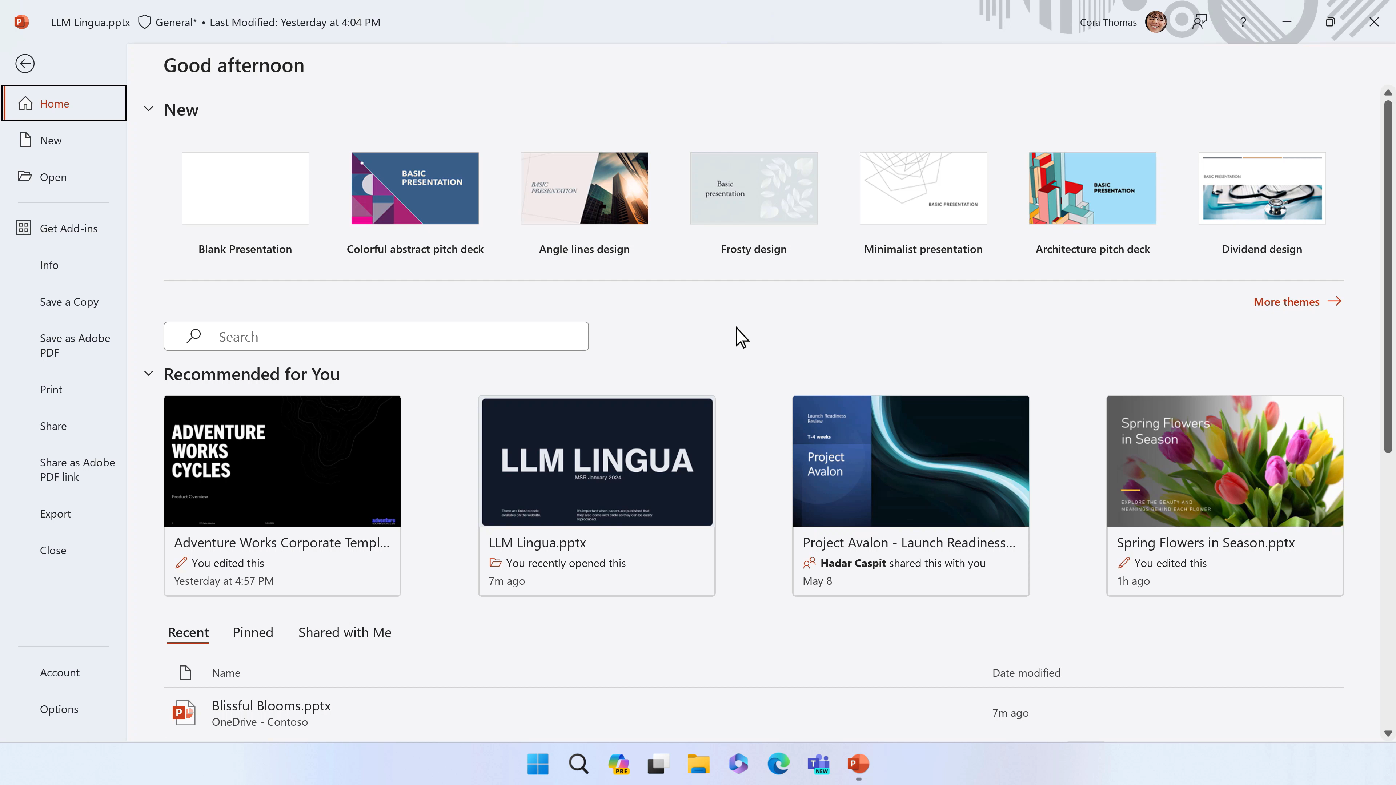
Summarize and understand a presentation (video)

Slide 7
Refine and edit
Effortlessly organize your presentation, replace an image with Copilot, and update the slide design in second with Designer
Notes:
Effortlessly organize your presentation, replace an image with Copilot, and update the slide design in seconds.

Slide 8
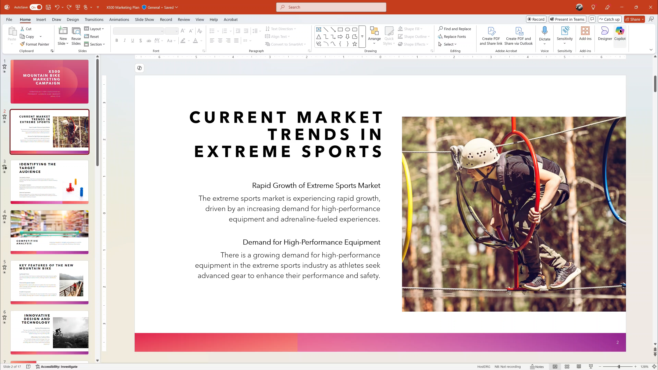
Adding additional structure to a presentation
Notes:
00:00 - I have a presentation that needs some additional structure.
00:05 - I'll ask Copilot to organize my slides for me.
00:10 - Copilot will analyze my slides and create new sections and header slides, and even add an agenda slide.
00:29 - Once it is done, I can jump over to slide sorter view to look at my improved deck.
00:36 - There is an image that could be improved.
00:38 - I'll ask Copilot to find a better one for me.
00:52 - And now I can use Designer to try out new slide layouts with just one click.
00:56 - Copilot helps me focus on my storytelling and not worry about tedious tasks.
PORTIONS SPEED UP FOR TIME

Slide 9
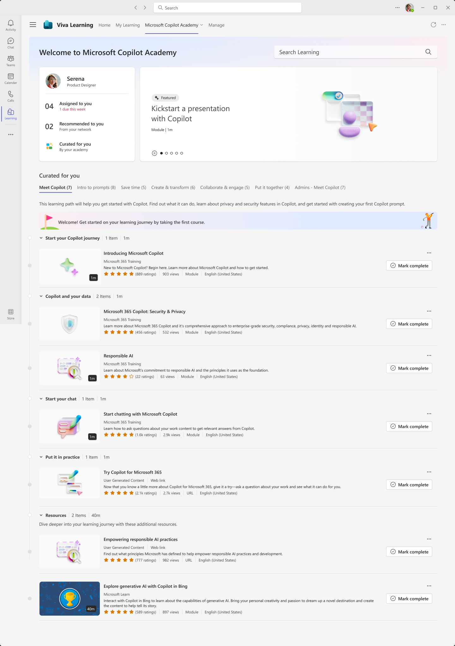
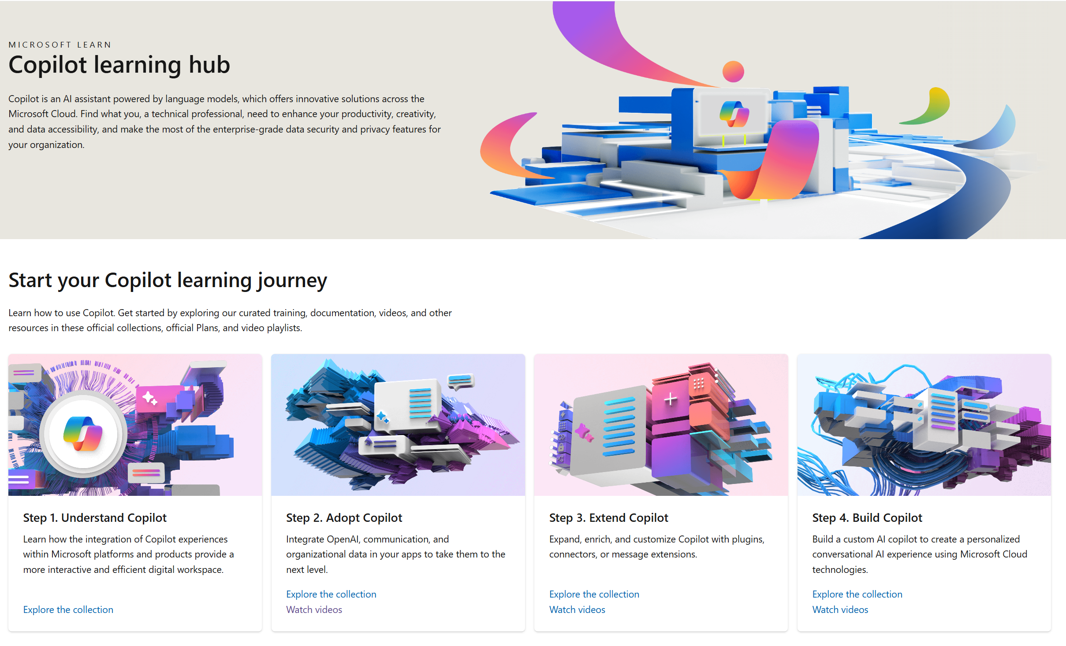
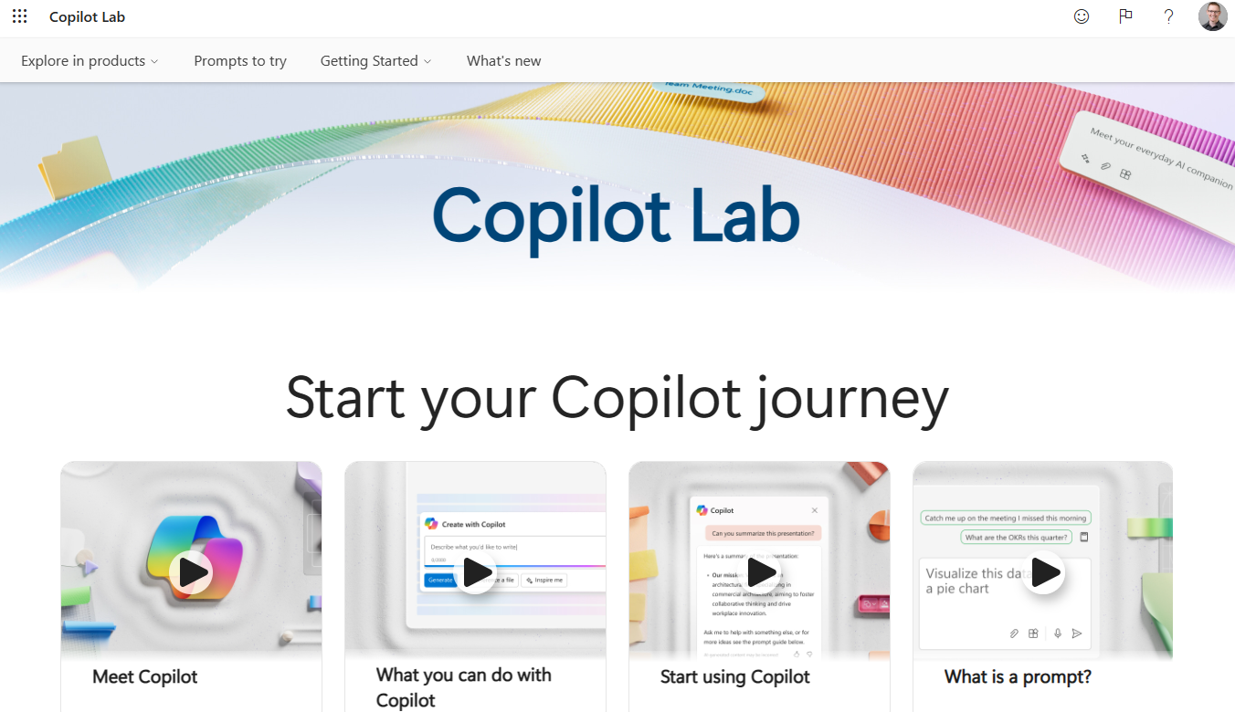
Skilling experiences
Microsoft 365 Copilot
Microsoft Copilot Academy
Available to all Microsoft 365 Copilot customers
Centralized location to help with the basics of Copilot learning and upskilling, pulling the best content from available free Microsoft sources
Structured content in easily consumable learning paths curated by Microsoft experts
Develop your AI interaction skills from your Viva Learning app in Teams or webapp
Microsoft Learn
Free, on-demand training content for skill development
Step-by-step exercises guiding learners through common Copilot prompts and use cases
Copilot Prompt Gallery
Free location to meet, learn about, and test the capabilities of Copilot
Improve your prompt engineering skills in an interactive hands-on environment

Slide 10
Links to learn more (1 of 2)
Copilot Readiness Hub
What is Copilot?
Introducing Microsoft 365 Copilot
The Copilot System
ChatGPT vs. Microsoft 365 Copilot: What's the difference?
How Copilot works
How Microsoft 365 Copilot works: Microsoft Mechanics video
Semantic Index for Copilot
Microsoft Graph
Microsoft Graph connectors
Additional copilot experiences across the Microsoft Cloud
Microsoft Dynamics 365 Copilot
Copilot in Power Platform
Microsoft Security Copilot
GitHub Copilot
Copilot in Microsoft Stream
Privacy
Microsoft’s privacy policy
Microsoft Privacy Statement
Trust Center data protection and privacy
Data, privacy, and security for Microsoft 365 Copilot
Data, privacy, and security for Azure OpenAI Service
Role-based access control
User permissions and permission levels in SharePoint Server
Customer Lockbox requests
Microsoft 365 isolation controls
Data Protection Addendum

Slide 11
Links to learn more (2 of 2)
Data residency and storage
EU Data Boundary
Website
Blog
Documentation
Compliance
Microsoft Compliance
Service Trust Portal
Compliance offering definitions
General Dat Protection Regulation (GDPR)
Full summary
Short summary
Security
Configure usage rights for Azure Information Protection (AIP)
Universal Licensing Terms for Online Services
Data Protection Addendum
Isolation and Access Control in Microsoft 365
How to prepare for Microsoft 365 Copilot
Learn about Microsoft feedback for your organization
Manage Microsoft feedback for your organization
How to manage Microsoft Search
Microsoft 365 Product Terms
Content management and security in SharePoint, OneDrive, and Teams
Transcription Management in Microsoft 365 Copilot
Responsible AI
Responsible AI core principles
Videos
Documentation
Microsoft Responsible AI Standard
Governing AI: A Blueprint for the Future

