Slide 1
Get started with Microsoft 365 Copilot in Excel
Practical examples and how-tos
Dec 2024
Notes:
Excel is a rich product with an incredible amount of functionality – so many different features that it can sometimes be challenging to know where to start for how to take advantage of them as part of your workflow. Building on that, Microsoft 365 Copilot in Excel adds even more functionality that’s useful for people who use Excel regularly for their work.
This presentation is intended to help you get an idea of how Copilot can be used in Excel to improve your workflows – how to take advantage of more of that rich functionality in Excel, and how to save time and be more efficient.

Slide 2
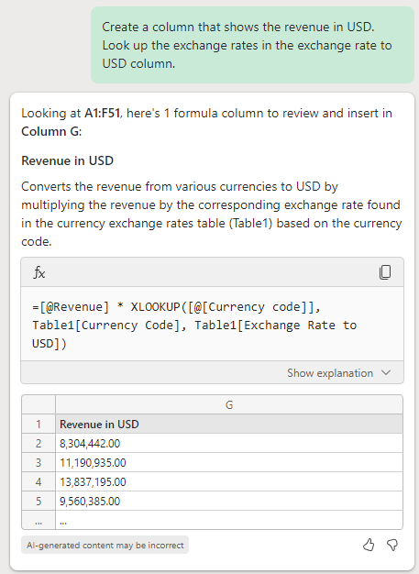
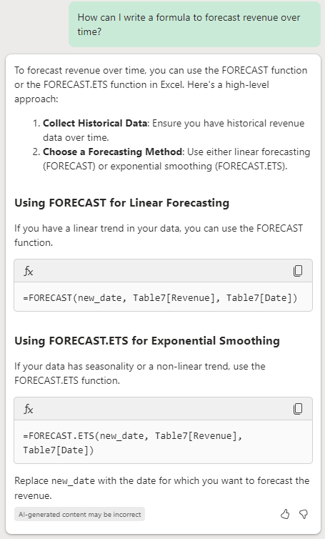
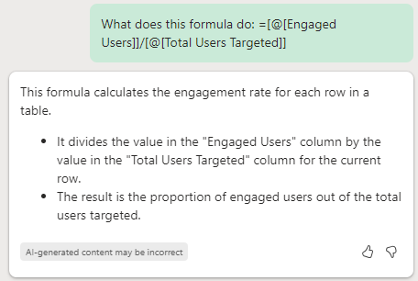
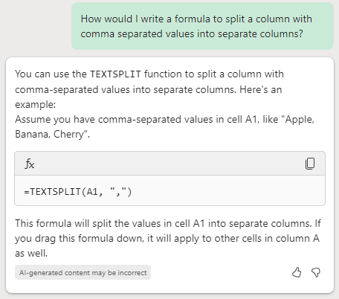
Formulas: Writing, explaining, and asking questions
Notes:
One of the parts of Excel that Copilot can help you with is with formulas – writing them, explaining them, troubleshooting errors, and so on.
This slide shows a few specific examples of some of those use cases as an introduction – later slides have more examples that also show the sample data used.

Slide 3
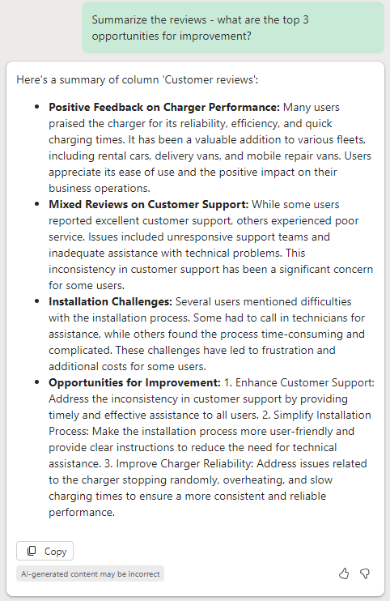
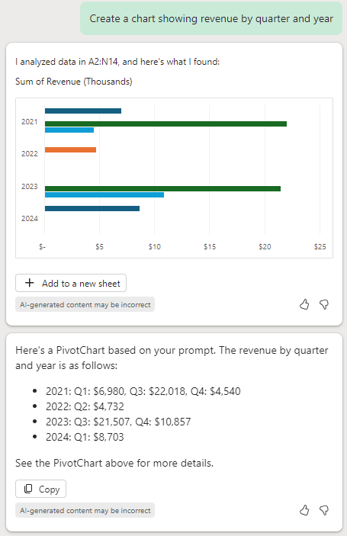
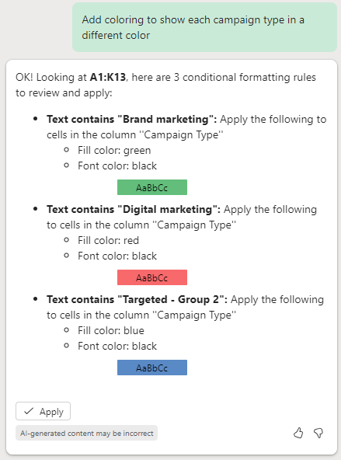
Analyze and visualize your data
Notes:
Another thing Copilot can help you with in Excel is analyzing and visualizing your data – summarizing survey verbatims, creating charts, using conditional formatting, and so on.
This slide shows a few specific examples of some of those use cases as an introduction – later slides have more examples that also show the sample data used.

Slide 4
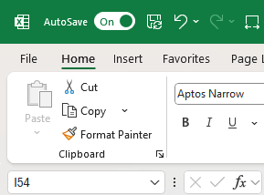
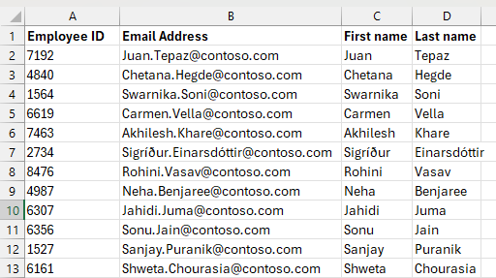
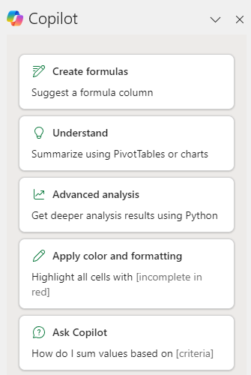
Getting started
Autosave on
“Table-less” Copilot
Open the chat pane
The file must be saved to OneDrive or SharePoint, with Autosave turned on.
Copilot works with data that’s either in an Excel Table (Insert | Table) format, or in a “Table-Like Range” with column headers.
Click on the Copilot button on the ribbon and try one of the starting prompts or write your own.
Notes:
A few things to know up front before you get started: #1: Copilot in Excel only works if the file is saved to OneDrive or SharePoint, with Autosave turned on. #2: Copilot works best with structured data – that includes data that’s in an Excel Table format (from Insert | Table), or in what are called “Table-Like Ranges” with headers for each column and no blank rows, such as the example on this slide. #3: Then, just click on the Copilot icon on the Home tab of the Ribbon to get started – try one of the starting prompts that show up or write your own.
This slide shows a few specific examples of some of those use cases as an introduction – later slides have more examples that also show the sample data used.

Slide 5
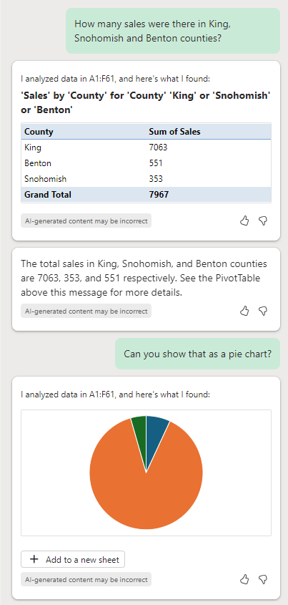
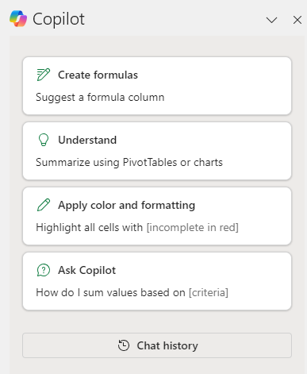
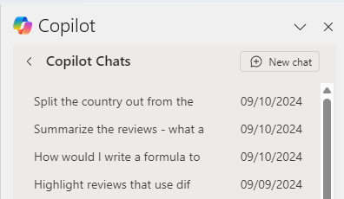
Tip: use multi-turn
Use multi-turn to add clarification or request changes.
If you don’t get what you want the first time, try saying “actually can you do XYZ instead” – that helps the model learn what you want.
Note that previous prompts/responses have informed Copilot’s latest response – create a new chat thread to start fresh.
Notes:
Here are some tips and tricks to get the most out of Copilot in Excel: “Multi-Turn” refers to the idea of having a conversation with Copilot in the chat pane – which is quite a different experience from clicking menus and buttons!
For example, if you don’t get the answer you wanted in your first prompt, try following up with more clarification or request changes – see the left-hand screenshot here for an example, where the first prompt was about sales volume for a specific filter, and after Copilot returned the response, the user asked for that information to be shown as a pie chart. Copilot keeps track of your conversation and knows what the word “that” meant in “Can you show that as a pie chart”.
Conversations are also helpful for helping the Large Language Model that powers Copilot learn what you want – if you don’t like Copilot’s first response, try saying “Actually instead of that, can you do <this> instead”.
Also be aware that previous prompts you wrote plus Copilot’s responses to those prompts have all informed Copilot’s most recent response – sometimes, that may not be what you want, in which case just start a new chat thread to start fresh. Click on the “Chat history” button and then “New chat” to start a new conversation with Copilot.

Slide 6
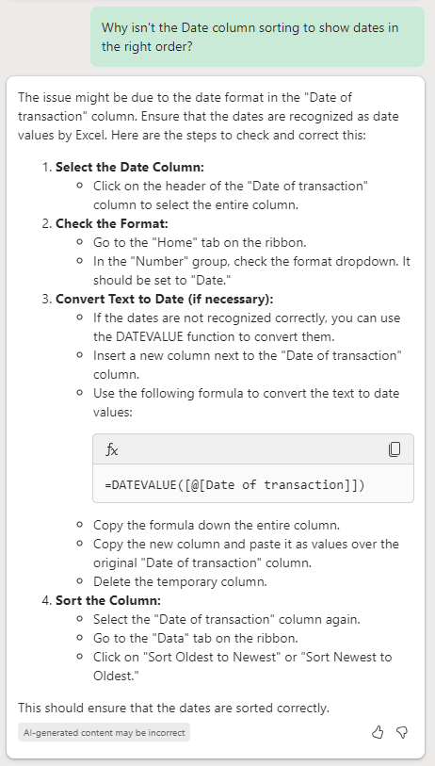
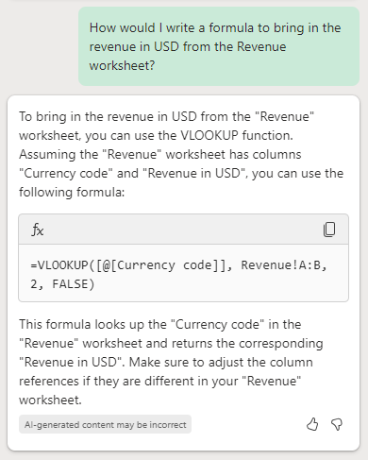
Tip: Ask “why” and “how” questions
Try asking Copilot why something isn’t working or how to do the task in Excel, instead of asking it to do it for you.
If Copilot doesn’t seem to understand what you want, try rephrasing your prompt with different words.
Please use the thumbs up and down to let us know your experience!
The Excel team spends a lot of time reviewing these – and include a screenshot if possible, that context is very helpful.
Notes:
Another tip for using Copilot if it’s not doing what you want – try asking Copilot “WHY” or “HOW” questions about your task, instead of asking Copilot to do the task for you.
Rephrasing your prompt with different words can also be helpful if it doesn’t seem to be understanding what you want. Although it may seem counter-intuitive, sometimes adding *more* detail and words helps Copilot better understand what you’re looking for.

Slide 7
Working with text

Slide 8
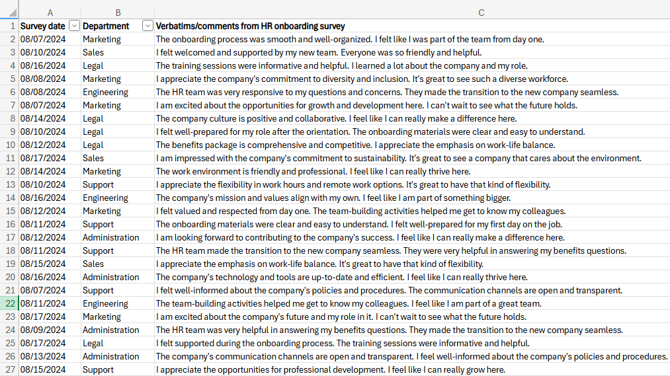
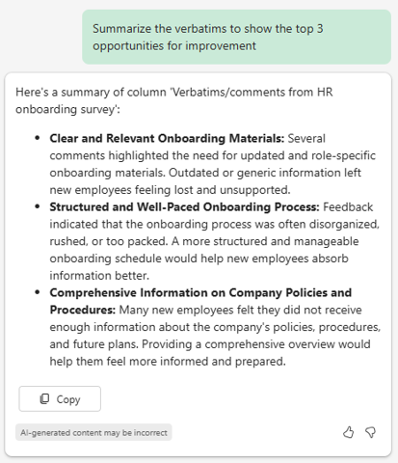
Summarize a column of text
Source: Any dataset with a text-heavy column, such as survey verbatims.
Prompt 1: Summarize <column> to show the top 3 opportunities for improvement.
Notes:
One common scenario for Excel is managing results from surveys, which often include text verbatims and comments.
With Copilot in Excel, you can now ask for summaries of text-heavy columns such as in this example, where there were verbatims from an HR onboarding survey for newly hired employees, and the user asked Copilot to summarize those verbatims to show the top 3 opportunities for improvement.
Also note that in this particular example, Copilot in Excel was used to generate the verbatims in this screenshot! ☺ To test that out yourself, ask Copilot to generate sample reviews for a particular product or business. Add details to describe the product or business, how long you want the reviews to be, how many you want to be positive vs negative, and give it guidance about including spelling errors.

Slide 9
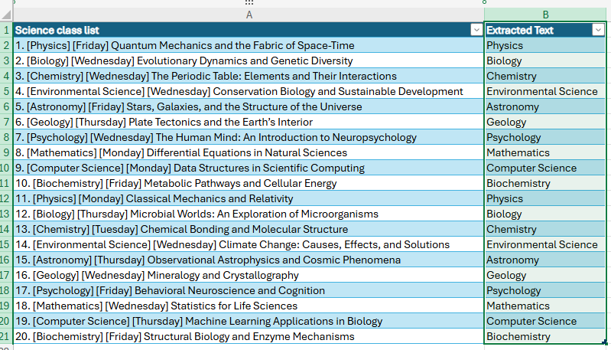
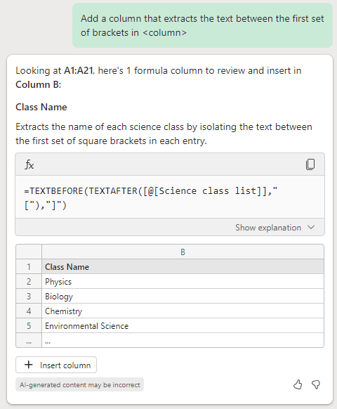
Extract <labels> from a text column into a new column
Source: Any dataset with a column that contains text you want to extract to new columns.
Prompt: Add a column that extracts the text between the first set of brackets in <column>.
Notes:
Another common scenario in Excel is that there may be a column with text in it where the text is structured in a certain way with tags or keywords, such as in this particular example where the subject of the class and the day of the week are enclosed in brackets.
If you have text like that in Excel, try asking Copilot to extract the text tags/keywords, and describe the structure of the data in your prompt. In this case, the user asked Copilot to “add a column that extracts the text between the first set of brackets in the science class list” and Copilot correctly pulled out the class subject.

Slide 10
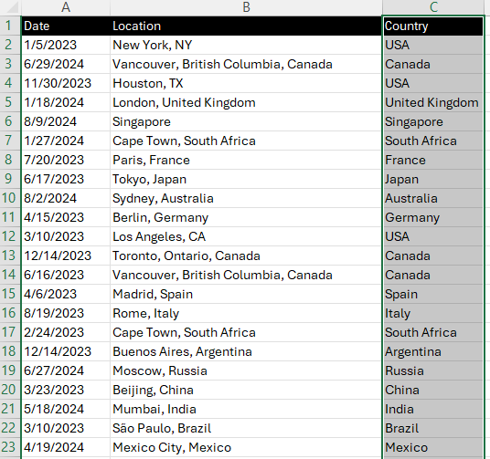
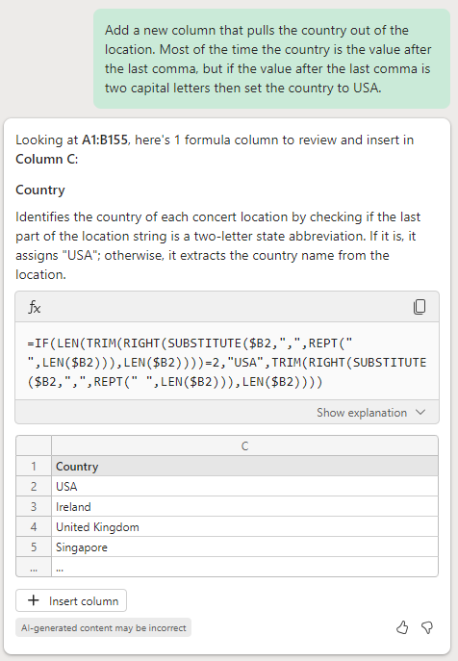
Split text into two columns
Source: Any dataset with a column that contains text you want to extract to a new column. Add more details to the prompt as needed for the complexity of the data.
Prompt: Add a new column that pulls the country out of the location. Most of the time the country is the value after the last comma, but if the value after the last comma is two capital letters, then set the country to USA.
Notes:
Continuing on the theme of text in Excel, another common scenario is that there might be a column with a comma-separated value in it, such as this case where column B has a location. In this example you can see that the Location column does consistently use commas – but different locations are represented in different ways, such as “City, State” for locations in the US, “City, Province, Country” for Canada, “City, Singapore where the city is the same as the country, and “City, Country” for other examples. With this prompt, the user asked Copilot to pull the Country out of the Location column into a separate column, and Copilot wrote a formula to dynamically do that. An important note about this example: When Copilot is generating a new column with a formula in it, it uses a sampling of rows of your data to come up with a proposed formula – and depending on the sample it uses, it may not cover all of the possible cases. Adding more details to the prompt in this case helped Copilot understand exactly what to do – aka MOST of the time the country is the value after the last comma, but there was special handling required for a few types of locations, such as locations in the US.

Slide 11
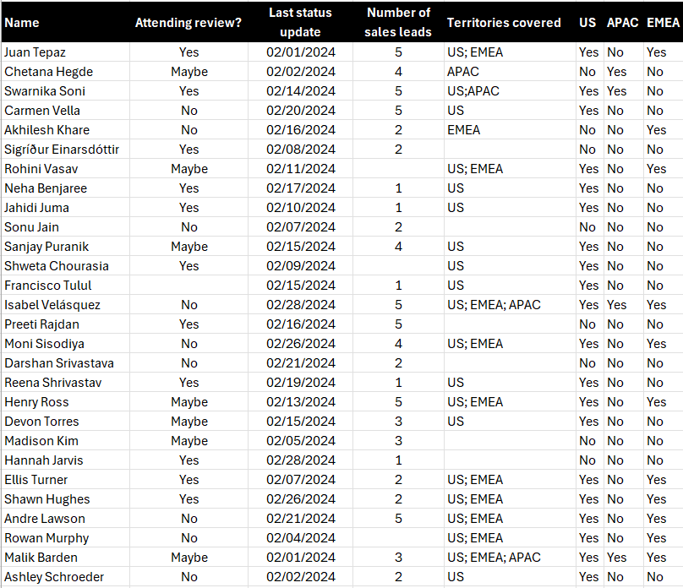
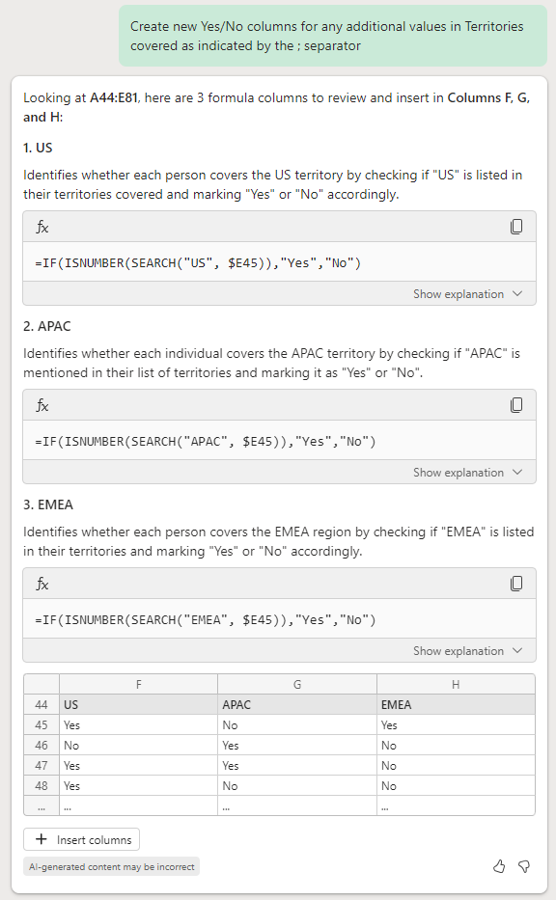
Separate delimited text into separate yes/no columns
Source: Any dataset works, have a column with text in it with separators like semicolons (;) in the values.
Prompt: Create new Yes/No columns for any additional values in <ColumnName> as indicated by the semicolon (;) separator.

Slide 12
More formula use cases

Slide 13
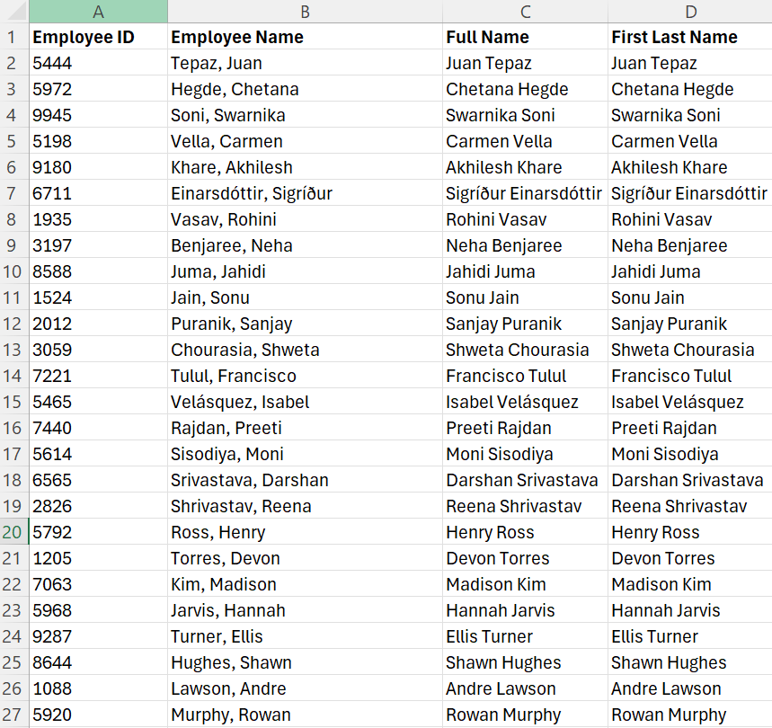
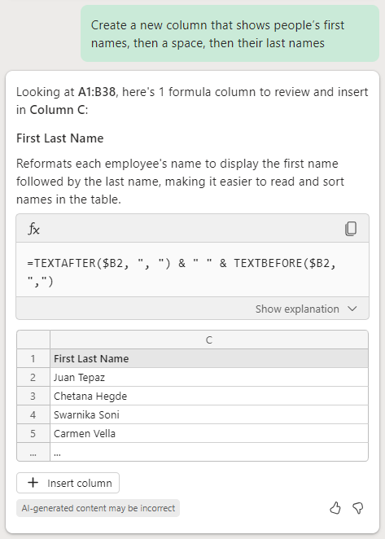
Change a list of full names from “Last, First” to “First Last”
Source: Any dataset with a list of names in “Last, First” format.
Prompt: Create a new column that shows people’s first names, then a space, then their last names.
Notes:
If you have a dataset in Excel that has a list of names in the format “Lastname, Firstname” with a comma between them, you can ask Copilot to add a new column that shows the names in a different order such as “Firstname Lastname” with a space instead.

Slide 14
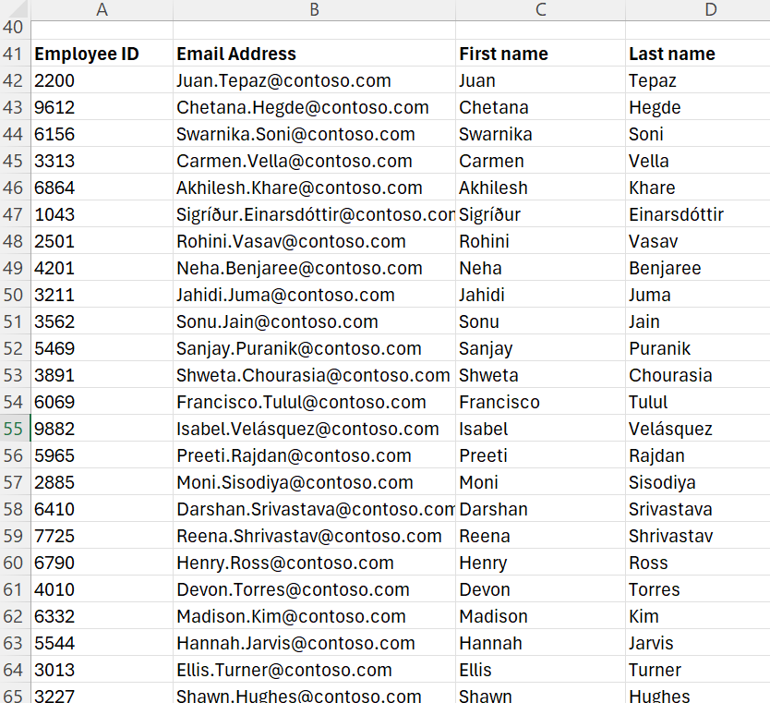
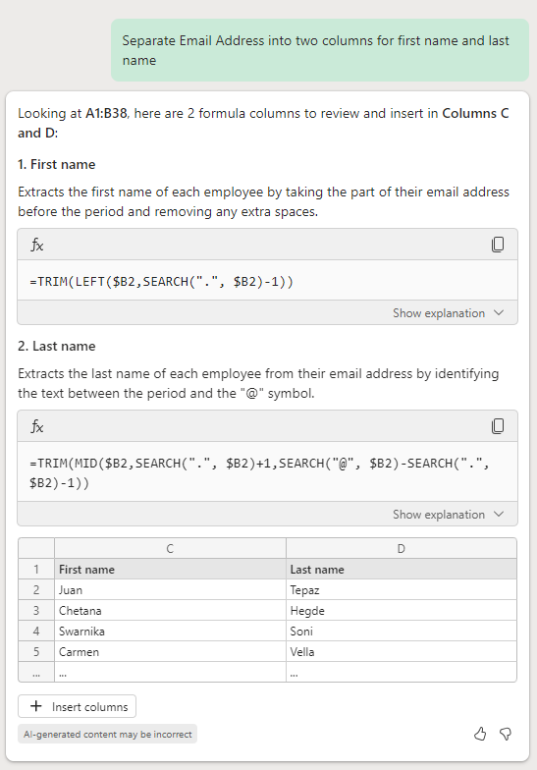
Separate first.last@email.com addresses
Source: Any dataset with a list of email addresses in firstname.lastname@domain.com format.
Prompt: Separate <column with email addresses> into two columns for first name and last name.
Notes:
Another name-based example is around email addresses, which are often in the format of FirstName.LastName@domain.com. This prompt asks Copilot to separate the email address into separate columns for first and last names, and Copilot figured out the structure of the email addresses in order to do this.

Slide 15
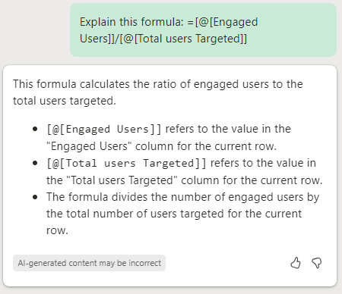
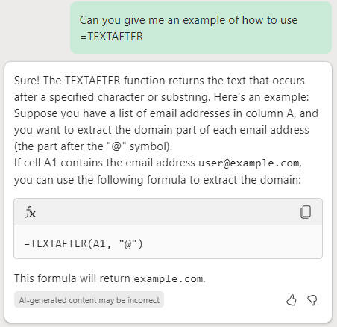
Formula help
Prompt 1: Explain this formula: <example of an Excel formula>.
Prompt 2: Can you give me an example of how to use =FORMULANAME in Excel.
Explain a specific formula.
Ask for an example of how to use a specific formula.
Notes:
Another way to take advantage of Copilot in Excel is with explaining a formula in an existing workbook, or asking for examples of how to use specific Excel formulas.
You can also give Copilot additional details in the prompt to explain exactly what you mean – for example if you want to know how to use a particular formula in more detail, try explaining the conditions you want the formula to handle, such as referencing a cell two columns to the left.

Slide 16
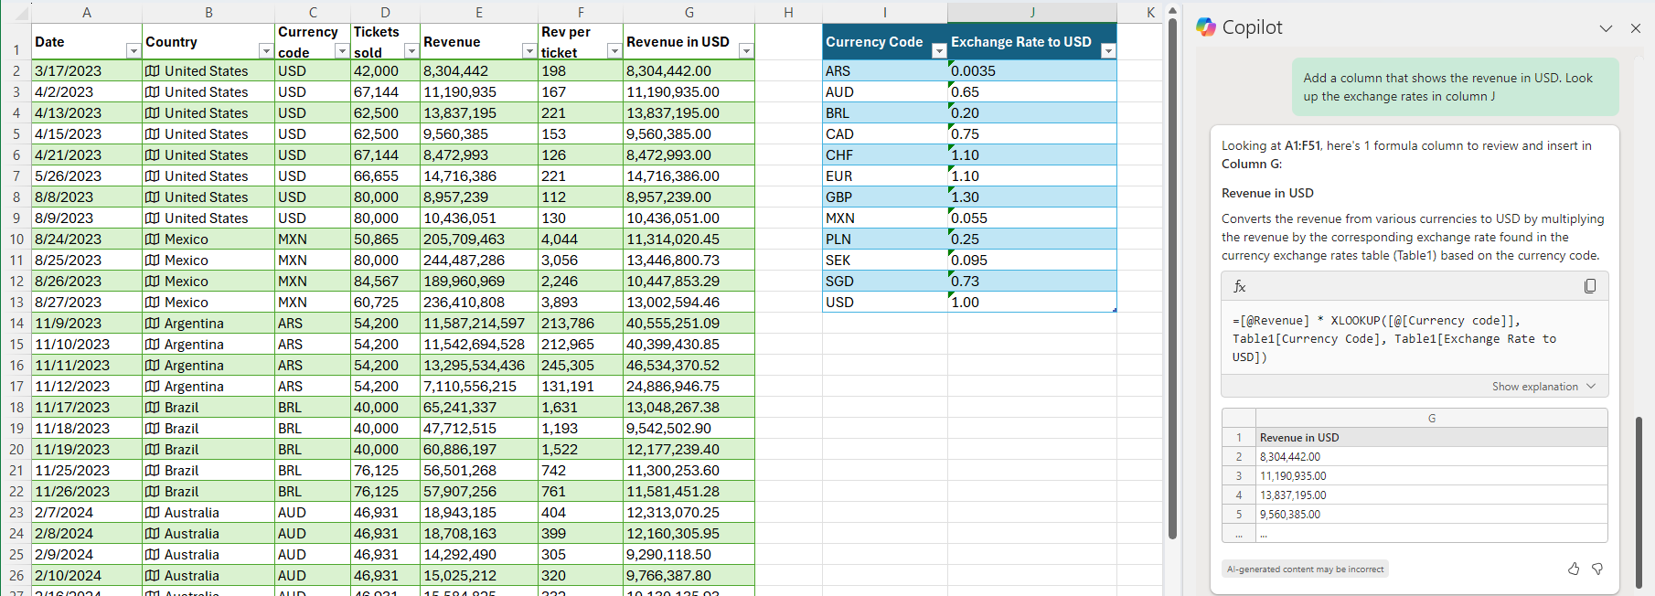
Lookups and cross-references across tables/ranges
Prompt: Add a column that shows the revenue in USD. Look up the exchange rates on [worksheet name or column name].
Notes:
XLOOKUP is a really powerful formula for linking information across worksheets or across different data ranges on the same worksheet. With Copilot, however, you don’t have to be an expert with using XLOOKUP to use it. In this example, the user wanted to convert the Revenue in column E which was in local currencies into a common currency (USD), and so the prompt told Copilot where to look up the Exchange Rates for the currency conversion in natural language – and Copilot wrote the formula for them.

Slide 17
Visualize – charts and color

Slide 18
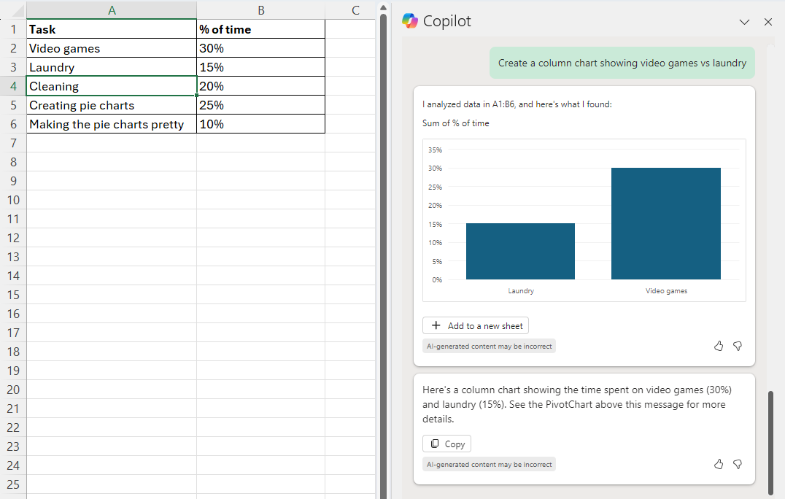
Create a column chart and filter to a subset of values
Source: Copy/paste sample below.
Prompt: Create a column chart showing <RowName1> vs <RowName2>.​‌
Task | % of time
Video games | 30%
Laundry | 15%
Cleaning | 20%
Creating charts | 25%
Making the charts pretty | 10%
Notes:
This is a really simple example to illustrate the broader capability of having Copilot create Pivot Charts. In this case the prompt asks for a column chart and asks for it to be filtered to only two values – but the user could have asked for a different type of chart (such as a pie chart in this case, or a line chart showing a trend over time for a different dataset), or they could have asked for different filters.

Slide 19
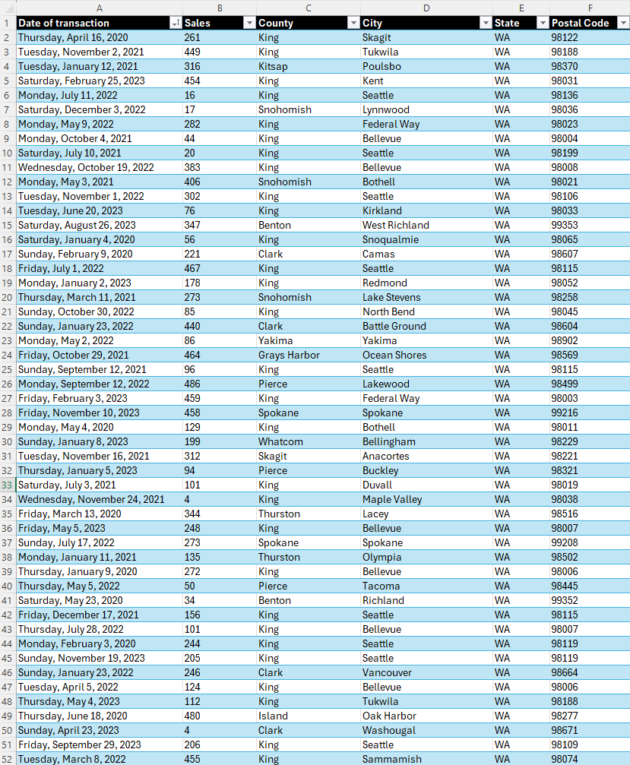
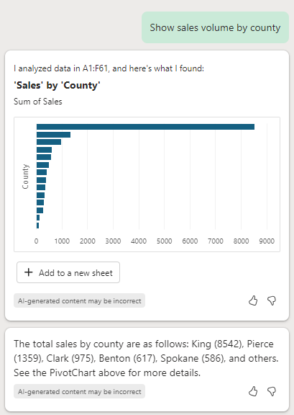
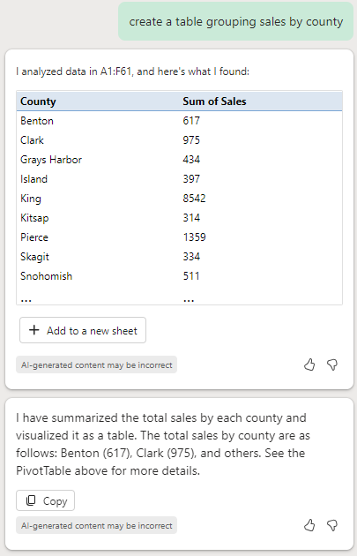
Creating tables and charts with filters
Prompt 1: Show sales volume by county.
Prompt 2: Create a table grouping sales by county.
Notes:
And here’s a more real-world example – the prompt of “show sales volume by county” for this dataset didn’t specify which kind of chart and Copilot decided that a bar chart was the best way to represent this particular data. The user can click “Add to a new sheet” which would add a new worksheet with that Pivot Chart on it. Or the user could ask for a table that’s grouped by one of the values in the data, such as County in this case.

Slide 20
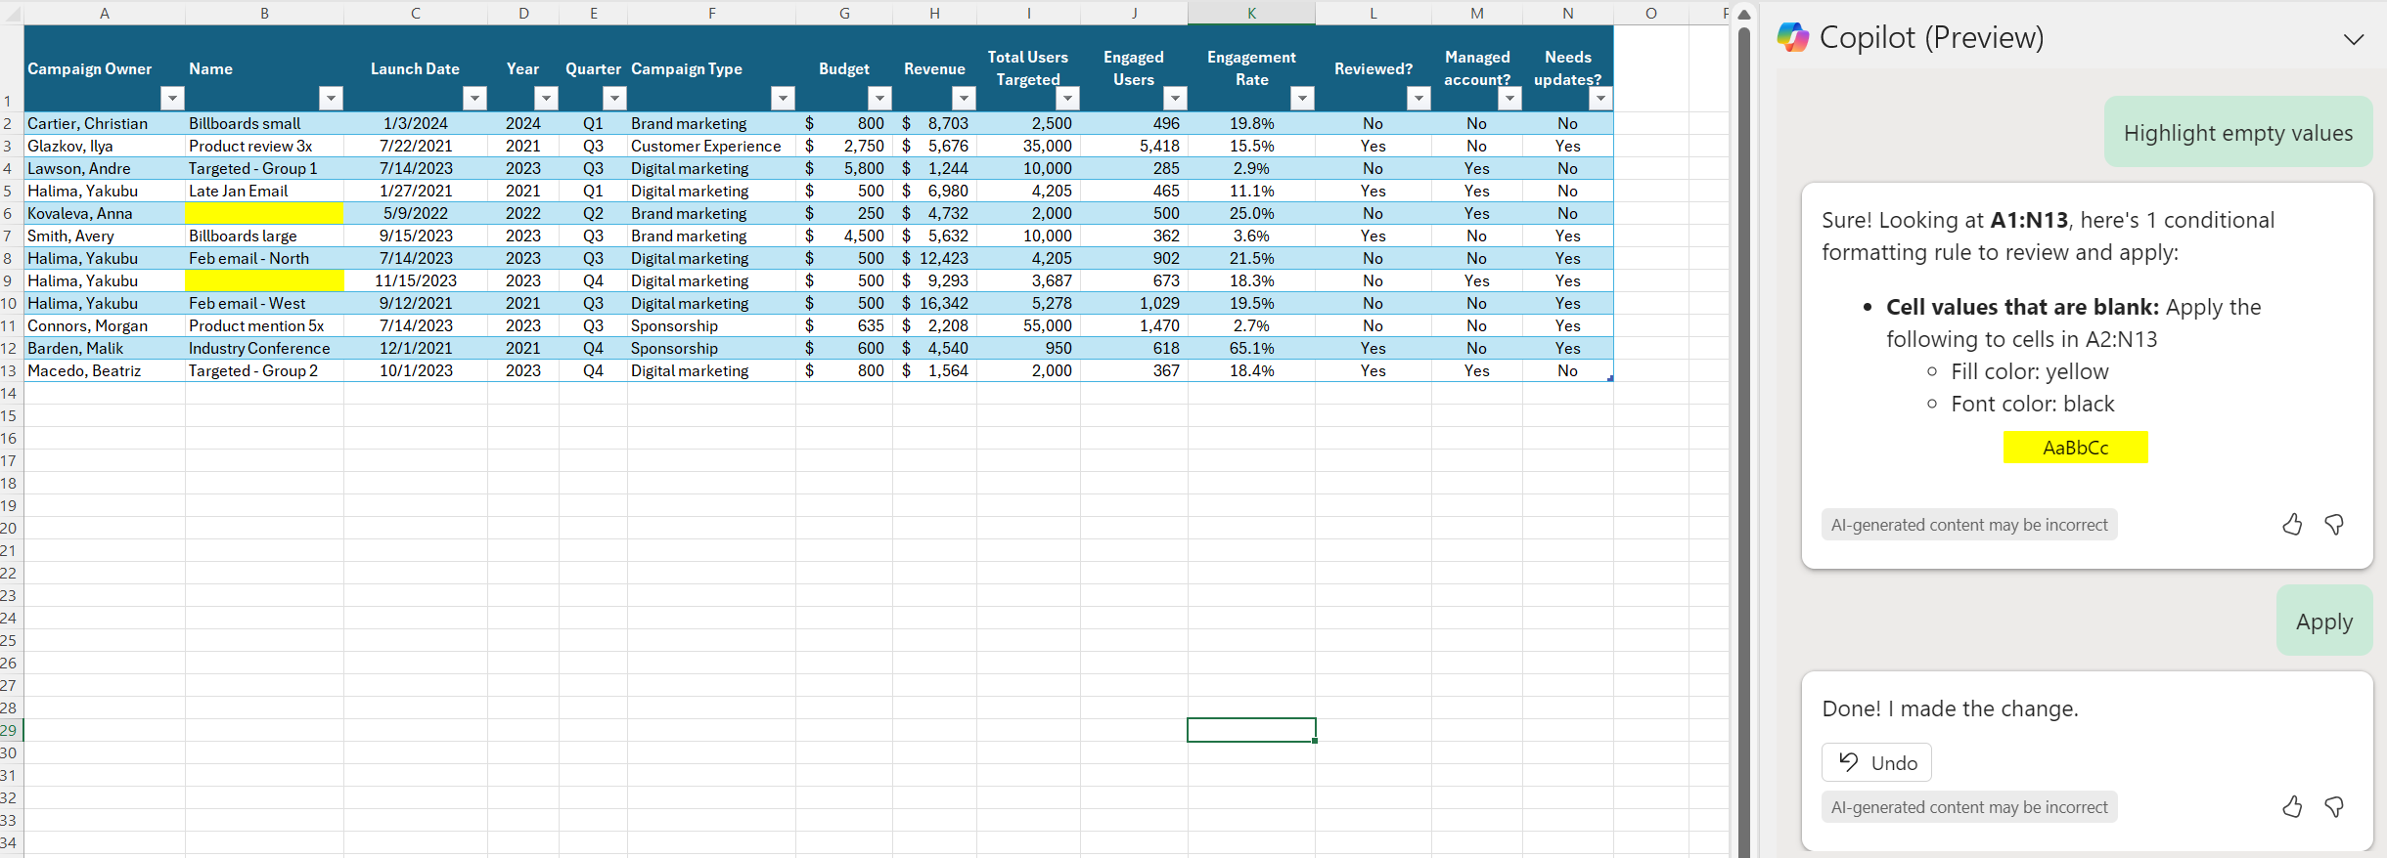
Beginning your highlighting – empty values
Source: Any dataset works with some values blank in a column.
Prompt: Highlight empty values in <column name> yellow.
Notes:
Copilot in Excel can also help you create conditional formatting rules to dynamically add color to your worksheet – such as in this case where the user is working on filling out some data and wants to use color as a way to indicate where the data entry isn’t complete, so they ask Copilot to highlight empty values. Note that this is a conditional formatting rule, so it’s dynamic – once that rule is applied to the table or range, if you were to delete the value in another cell, it would then be highlighted since it would be empty.

Slide 21
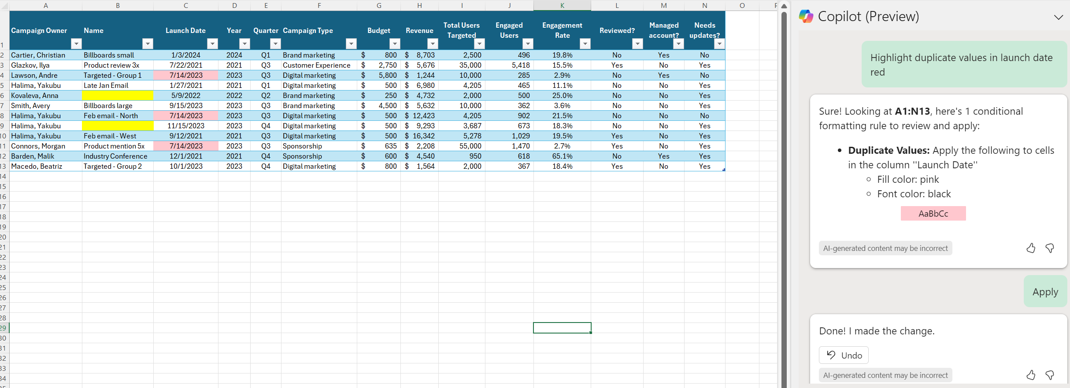
Continue your highlighting – duplicate values
Source: Any dataset works. Have some duplicate values in a column, or two rows that are duplicates of each other.
Prompt: Highlight duplicate values in <column name> <color> .
Notes:
Building on the previous scenario, you can also have Copilot create a conditional formatting rule to highlight duplicate values – and in this case, the user’s prompt asked for that rule to be scoped to only the Launch Date column. You can also specify what color you want in the prompt, such as ‘red’ in this case. If you want Copilot to change the color of the text instead of the cell fill color, then the prompt could be tweaked to say “highlight the text of duplicate values in launch date red”

Slide 22
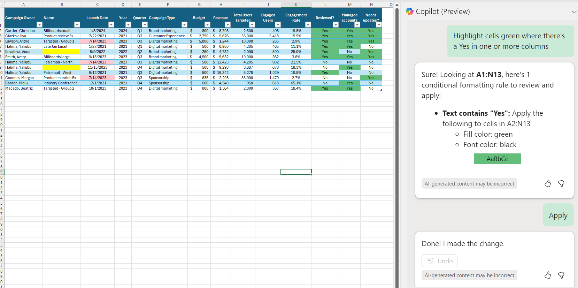
Finalize your highlighting – yes values
Source: Any dataset works.
Prompt: Highlight cells green where there’s a “yes” in one or more columns.
Notes:
And continuing to build on that example, another way to use Copilot to create Conditional Formatting rules is to make it easier to have certain values ‘pop’ visually with color – such as in this case where the data has a set of columns with Yes/No values in them, and the user wants to focus on the ones that have “Yes” in them.

Slide 23
Copilot in Excel with Python
Note: Copilot in Excel with Python is not yet generally available. See Copilot in Excel with Python - Microsoft Support for availability.

Slide 24
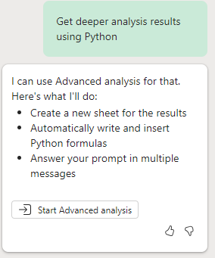
Getting started
Open the chat pane
Start analysis with Python
Click on the Copilot button on the ribbon and then select “Advanced analysis”
In the response card, select “Start Advanced analysis”
Notes:
A few things to know up front before you get started: #1: Open the chat pane and select the Advanced analysis card
#2: In the response card, select start Advanced analysis

Slide 25
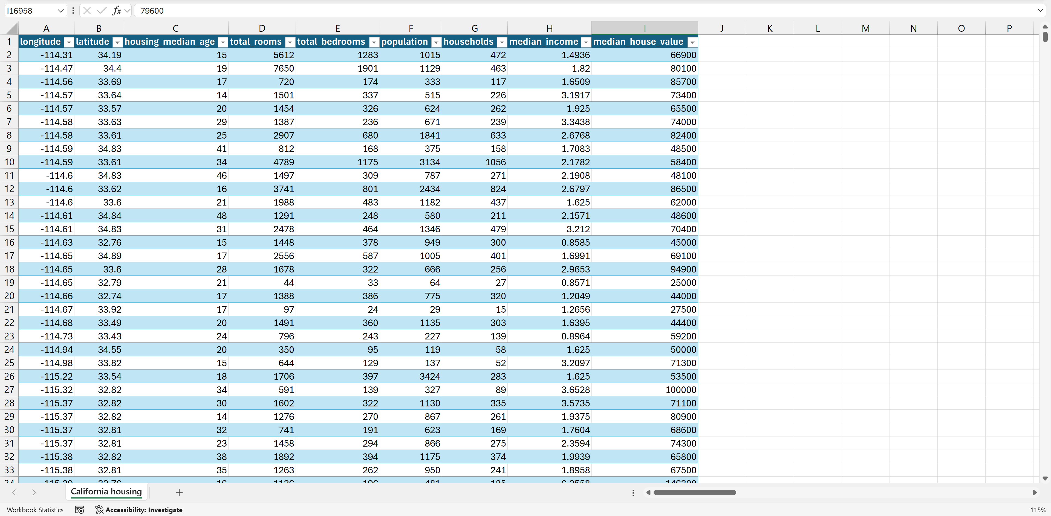
Clustering – Sample Data
Notes:
The first example will walk through a clustering example. Here is the sample data.

Slide 26
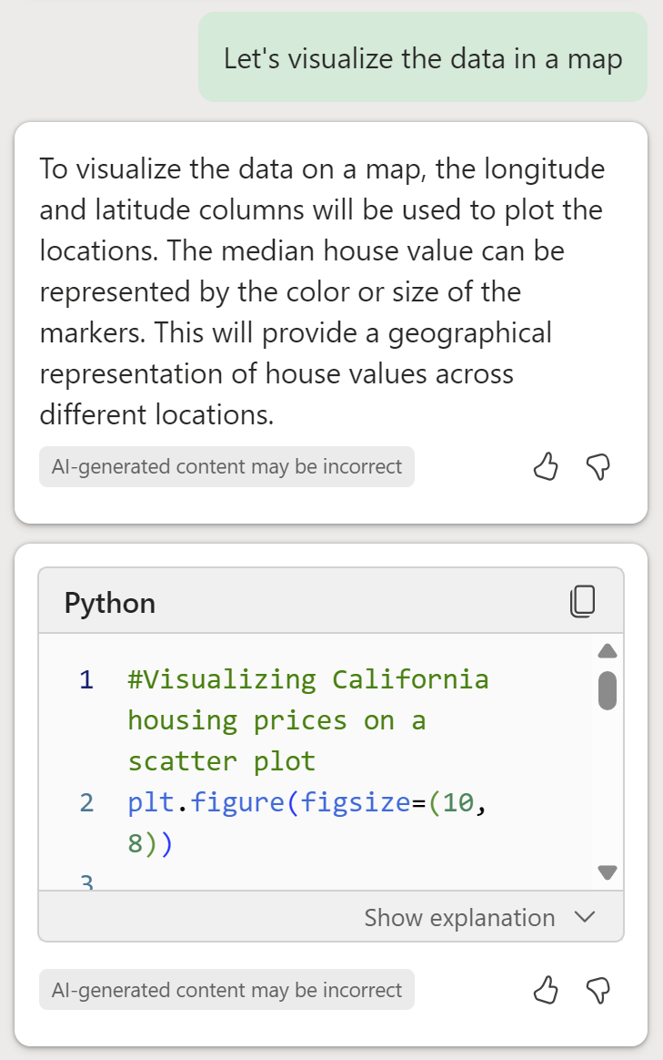
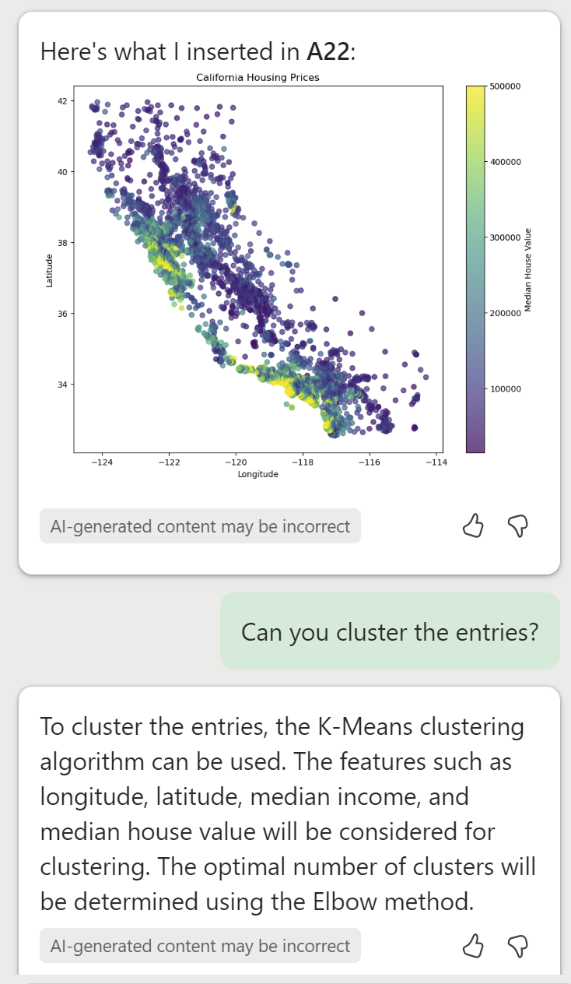
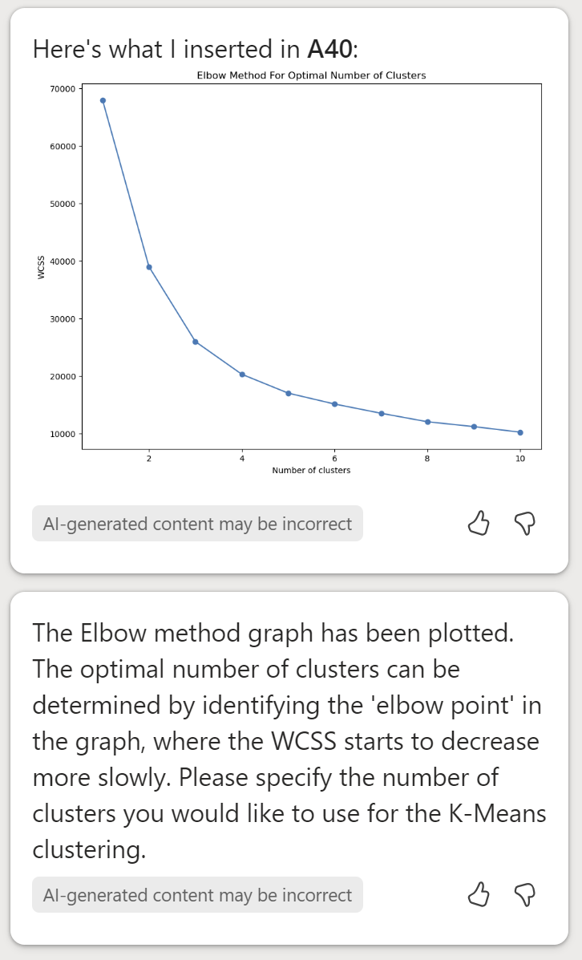
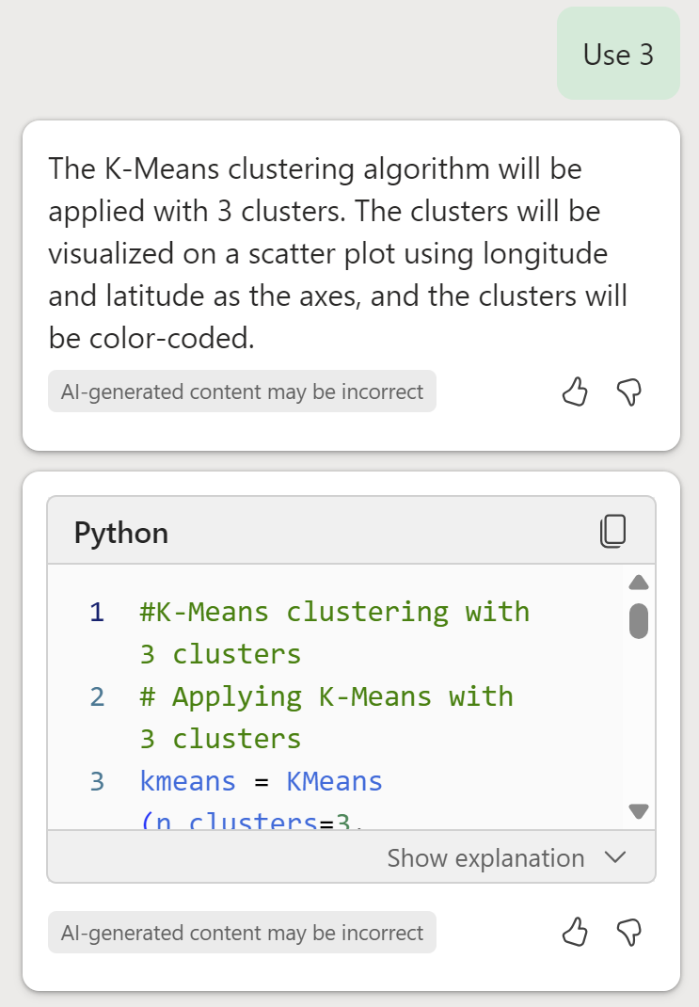
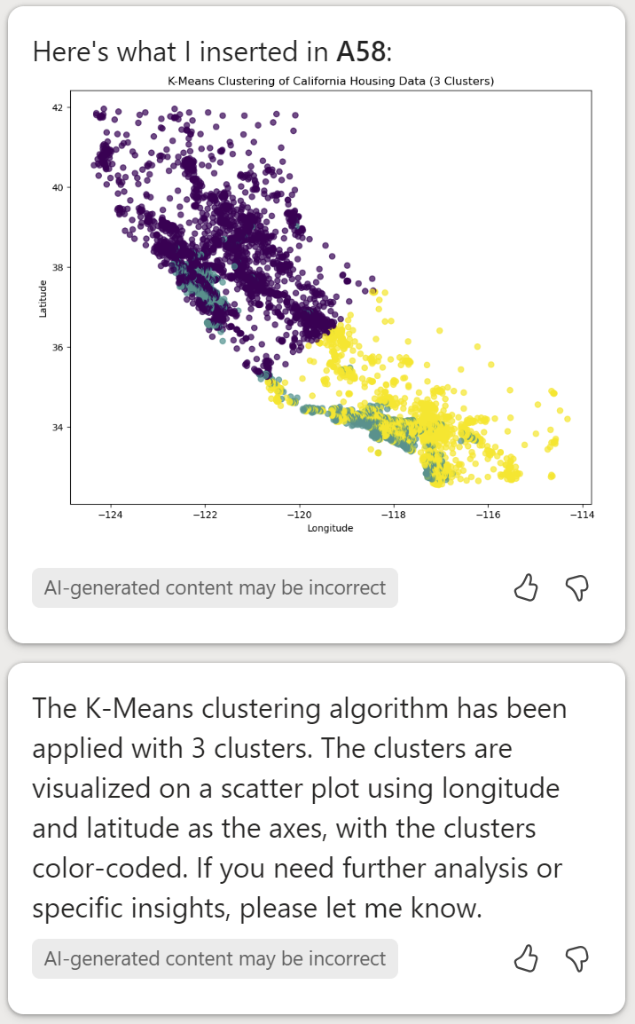
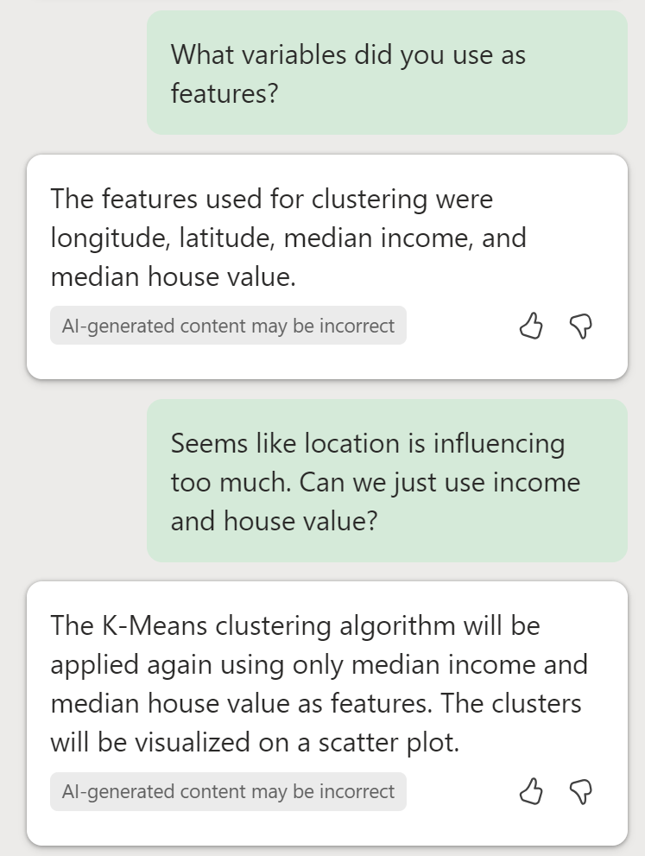
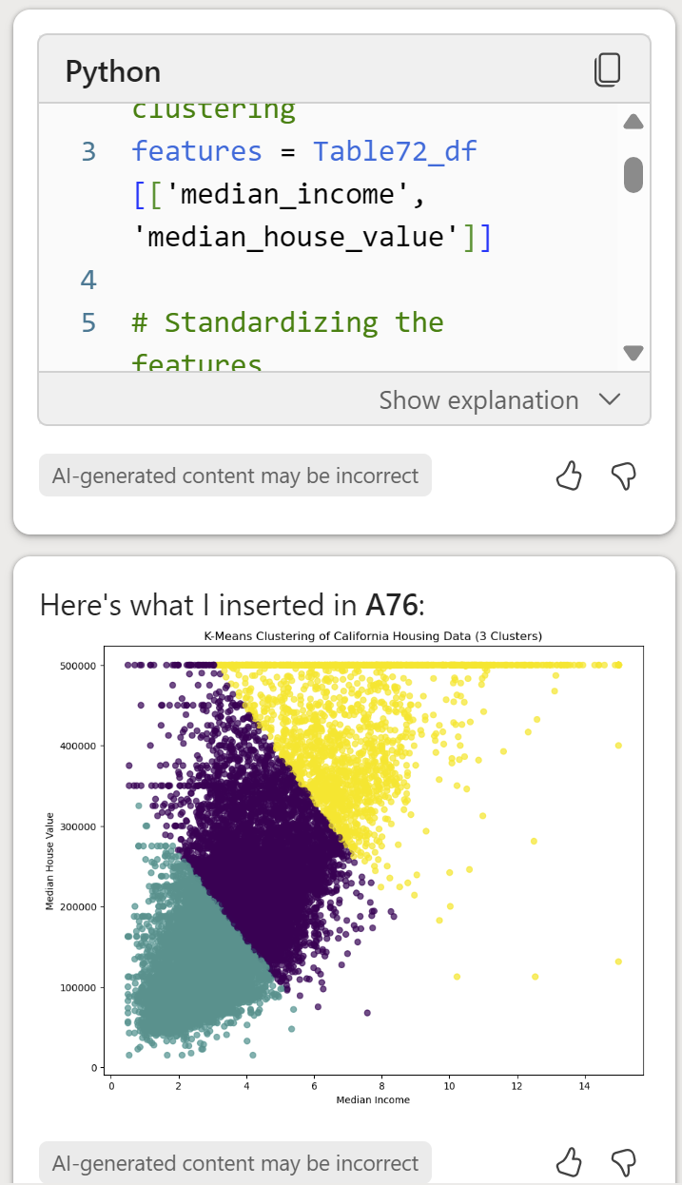
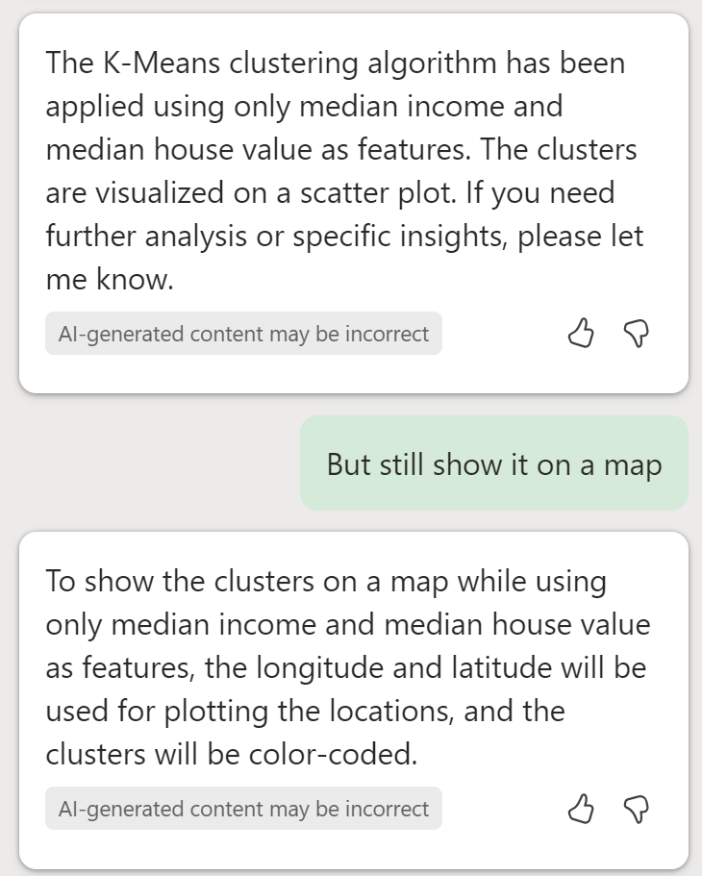
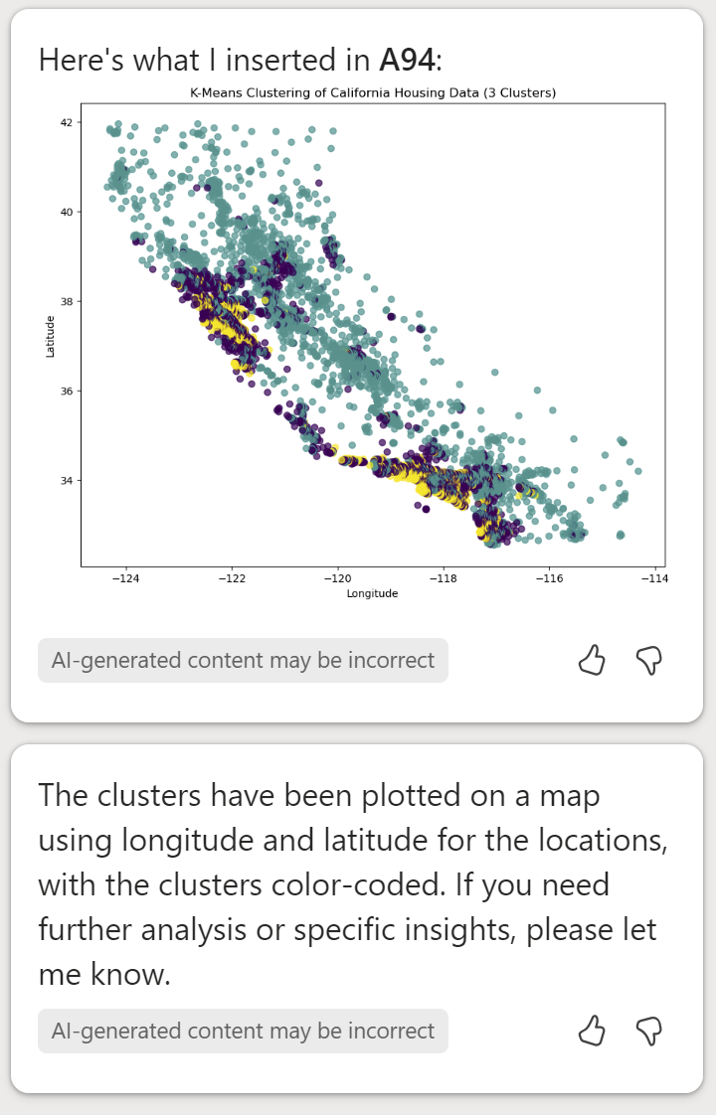
Clustering – Sample Prompts
Notes:
The prompts here show how to use Copilot in Excel with Python to visualize the data and cluster the data points.

Slide 27
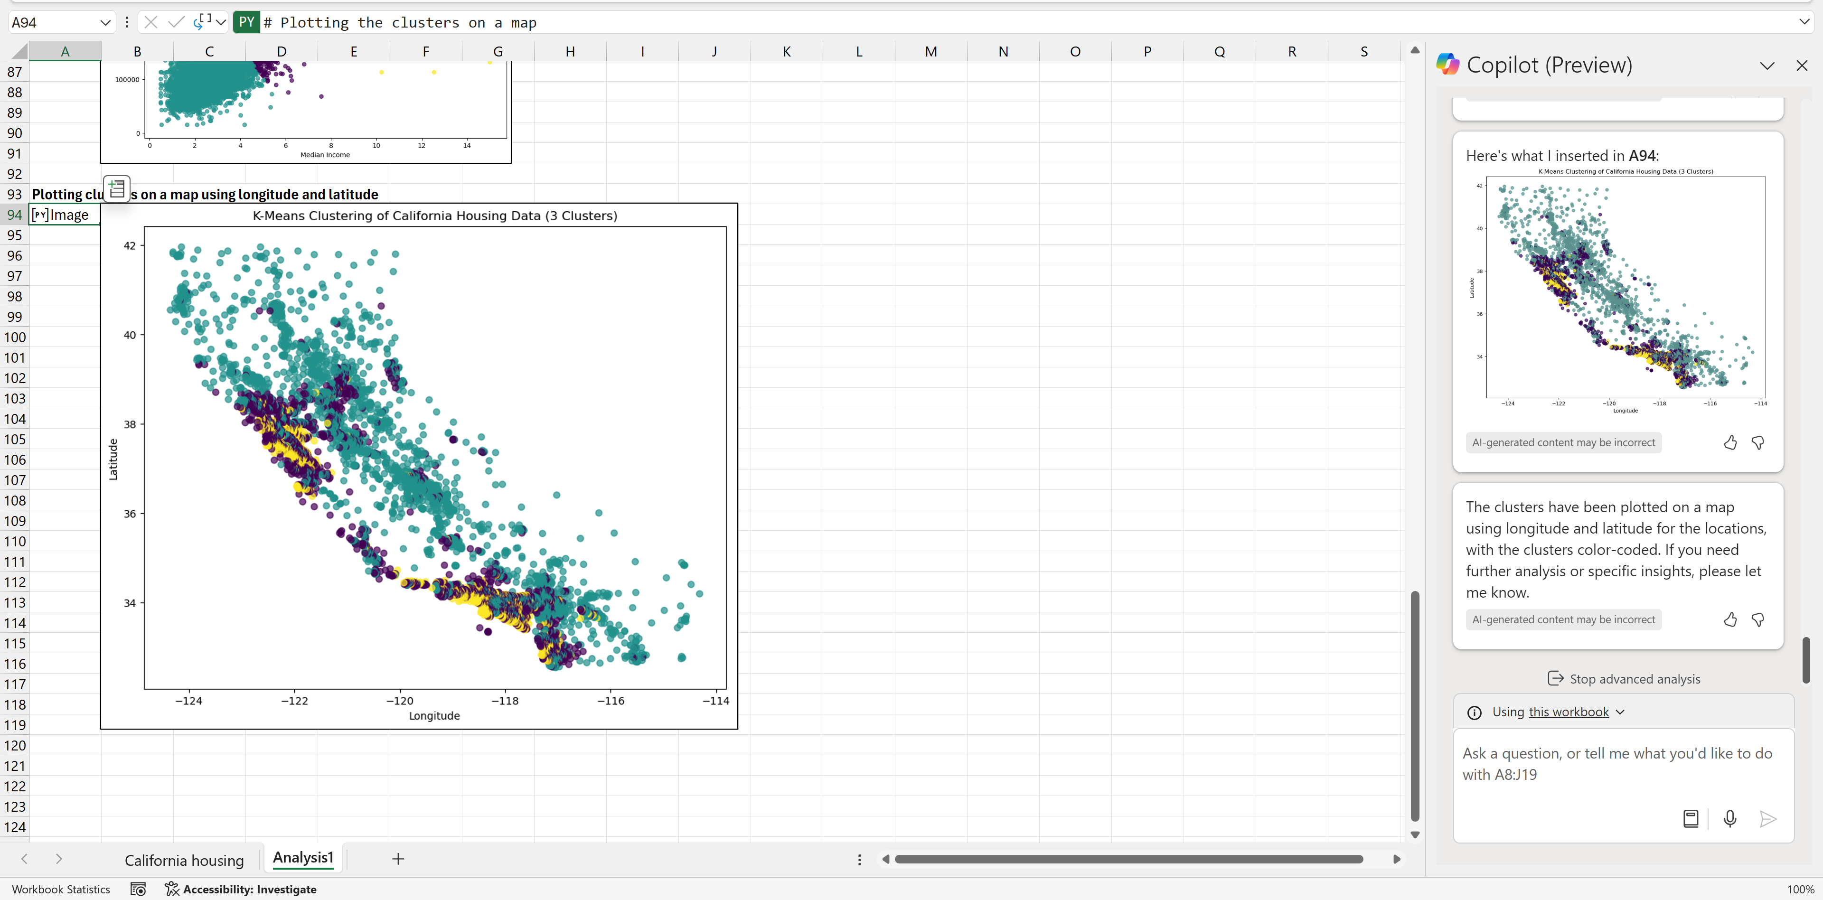
Clustering – Sample Analysis Sheet
Notes:
This is the worksheet after the last prompt.

Slide 28
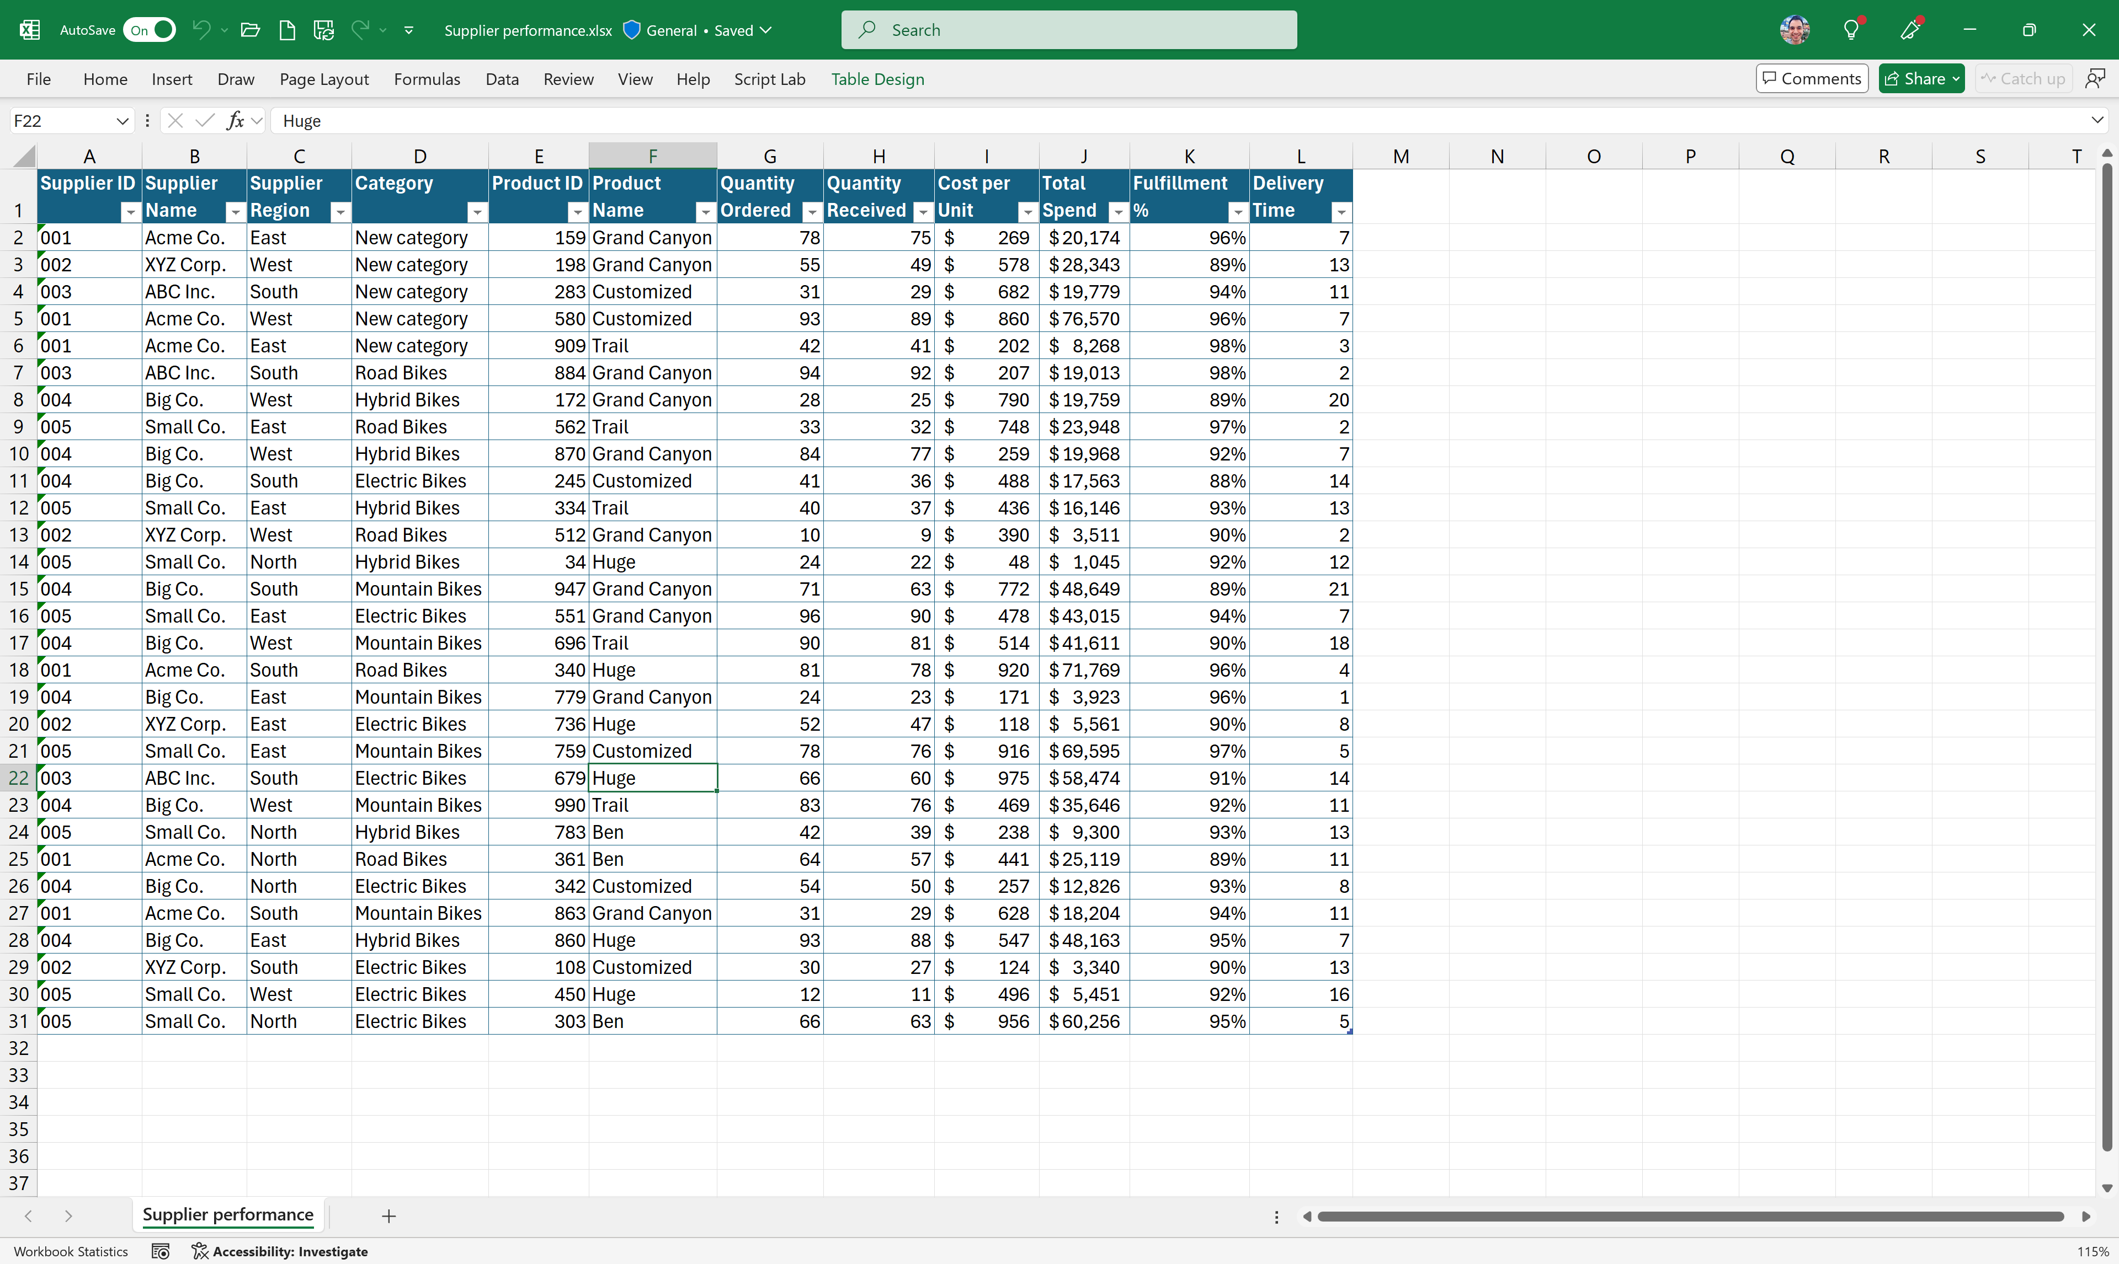
Supplier Ranking – Sample Data
Notes:
The second example will walk through a supplier ranking example. Here is the sample data.

Slide 29








Supplier Ranking – Sample Prompts
Notes:
The prompts here show how to use Copilot in Excel with Python to rank suppliers based on metrics calculated from the data.

Slide 30

Supplier Ranking – Sample Analysis Sheet
Notes:
This is the worksheet after the last prompt.

Slide 31

Forecasting – Sample Data
Notes:
The third example will walk through a forecasting example. Here is the sample data.

Slide 32








Forecasting – Sample Prompts
Notes:
The prompts here show how to use Copilot in Excel with Python to forecasting data with confidence intervals based on historical trends.

Slide 33

Forecasting – Sample Analysis Sheet
Notes:
This is the worksheet after the last prompt.

Slide 34

Visualizations – Sample Data
Notes:
The last example will walk through an advanced visualization example. Here is the sample data.

Slide 35



Visualizations – Sample Prompts
Notes:
The prompts here show how to use Copilot in Excel with Python to create advanced visualizations.

Slide 36

Visualizations – Sample Analysis Sheet
Notes:
This is the worksheet after the last prompt.

Slide 37
Ask questions about Excel

Slide 38



Ask questions about Excel
Notes:
Think of Copilot like having an Excel encyclopedia in your pocket.
If you can’t remember how to do something in Excel or if you want to learn how to do something in Excel, just ask Copilot!
Like in these examples: asking Copilot how to write a formula that forecasts revenue over time, or how to calculate the standard deviation, or about keyboard shortcuts.

Slide 39



Ask questions about Excel (continued)
Notes:
And lastly, a few more examples: The left-most screenshot shows an example of a user explaining to Copilot what they’re trying to achieve and asking for help on how to do it. Copilot both explains how to structure the data and then provides a formula to work against that data. Or in the middle screenshot, Copilot explains how to navigate the Excel user experience to access certain functionality in order to answer that user’s question.
Or in the right-most screenshot, think creatively about questions to ask Copilot around Excel – for heavy Excel users and enthusiasts, Copilot can be a really great way to get new ideas of how to get value out of Excel.

Slide 40



Skilling experiences
Microsoft 365 Copilot
Microsoft Copilot Academy
Available to all Microsoft 365 Copilot customers
Centralized location to help with the basics of Copilot learning and upskilling, pulling the best content from available free Microsoft sources
Structured content in easily consumable learning paths curated by Microsoft experts
Develop your AI interaction skills from your Viva Learning app in Teams or webapp
Microsoft Learn
Free, on-demand training content for skill development
Step-by-step exercises guiding learners through common Copilot prompts and use cases
Copilot Prompt Gallery
Free location to meet, learn about, and test the capabilities of Copilot
Improve your prompt engineering skills in an interactive hands-on environment

Slide 41
Links to learn more (1 of 2)
Copilot in Excel Blog for more examples
Copilot Readiness Hub
What is Copilot?
Introducing Copilot for Microsoft 365
The Copilot System
ChatGPT vs. Copilot for Microsoft 365: What's the difference?
How Copilot works
How Copilot for Microsoft 365 works: Microsoft Mechanics video
Semantic Index for Copilot
Microsoft Graph
Microsoft Graph connectors
Additional copilot experiences across the Microsoft Cloud
Microsoft Dynamics 365 Copilot
Copilot in Power Platform
Microsoft Security Copilot
GitHub Copilot
Copilot in Microsoft Stream
Privacy
Microsoft’s privacy policy
Microsoft Privacy Statement
Trust Center data protection and privacy
Data, privacy, and security for Copilot for Microsoft 365
Data, privacy, and security for Azure OpenAI Service
Role-based access control
User permissions and permission levels in SharePoint Server
Customer Lockbox requests
Microsoft 365 isolation controls
Data Protection Addendum

Slide 42
Links to learn more (2 of 2)
Data residency and storage
EU Data Boundary
Website
Blog
Documentation
Compliance
Microsoft Compliance
Service Trust Portal
Compliance offering definitions
General Data Protection Regulation (GDPR)
Full summary
Short summary
Security
Configure usage rights for Azure Information Protection (AIP)
Universal Licensing Terms for Online Services
Data Protection Addendum
Isolation and Access Control in Microsoft 365
How to prepare for Copilot for Microsoft 365
Learn about Microsoft feedback for your organization
Manage Microsoft feedback for your organization
How to manage Microsoft Search
Microsoft 365 Product Terms
Content management and security in SharePoint, OneDrive, and Teams
Transcription Management in Copilot for Microsoft 365
Responsible AI
Responsible AI core principles
Videos
Documentation
Microsoft Responsible AI Standard
Governing AI: A Blueprint for the Future

