Slide 1
Get started with
Microsoft 365 Copilot in Word
Practical examples and how-tos

Slide 2
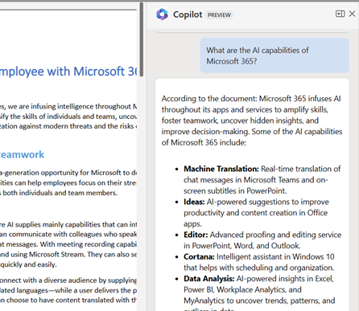
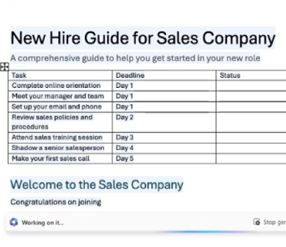
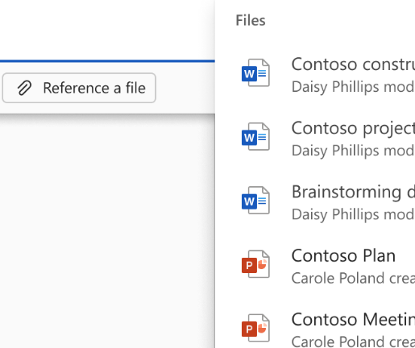
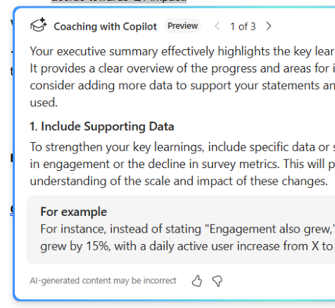
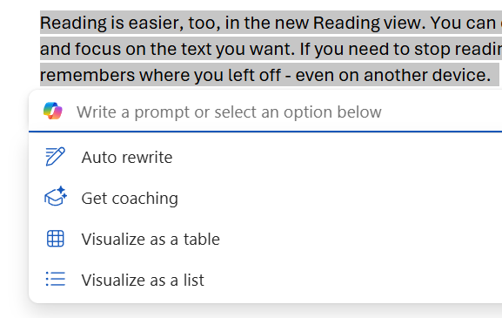
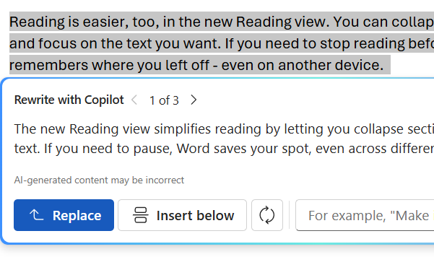
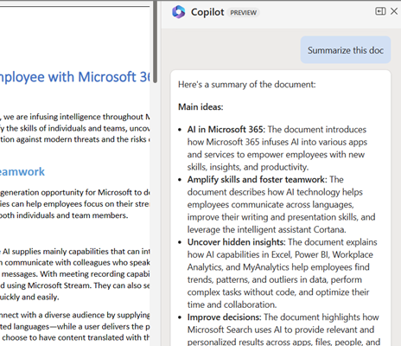
Copilot in Word overview
Ask questions in Chat
Draft & selections
Rewrite content
Visualize texts as a tables and lists
Document content grounding
Get coaching
Ask questions about your document, or broader questions from the graph or web
Summarize
5
Kick start content generation in a formatted and structured way, draft content to insert into an existing document, or select content to elaborate on or update it
Get suggestions for how to rewrite any text
Transform content from text format to a table
Draft with explicit grounding CIQ file support for Word, PPT, PDF, meetings, emails and people (coming soon)
Copilot provides suggestions on high impact ways to improve your writing
Get a summary with key points from your document via chat prompts or above the document.
Notes:
Copilot in Word includes a broad spectrum of functionality available both directly in the document canvas, and in the Copilot Chat pane. Users have support to draft new content to insert into the document or select content to modify with a prompt. Copilot also supports various quick actions available on selected content including Rewrite, Visualize as table, or get Coaching suggestions to improve your content. In the chat pane there is support to ask questions about the document content, or broader questions from the graph or web, as well as tailored support for document-centric comprehension requests such as generating a summary of the document content. In this overview we will explore these various capabilities in more depth.

Slide 3
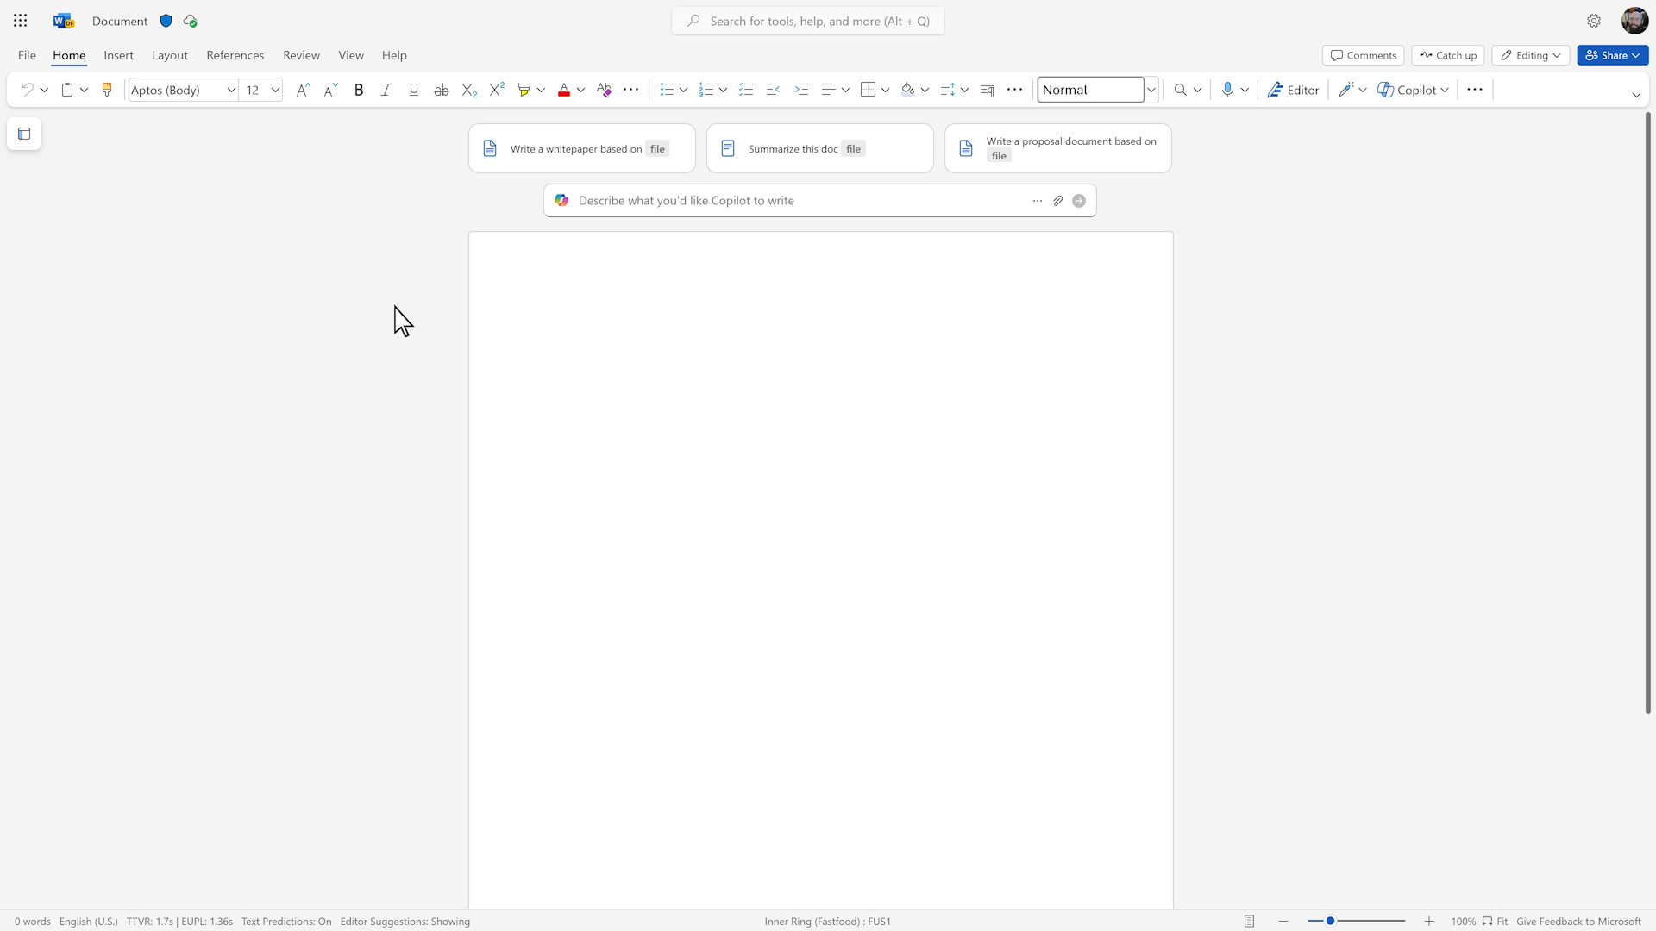
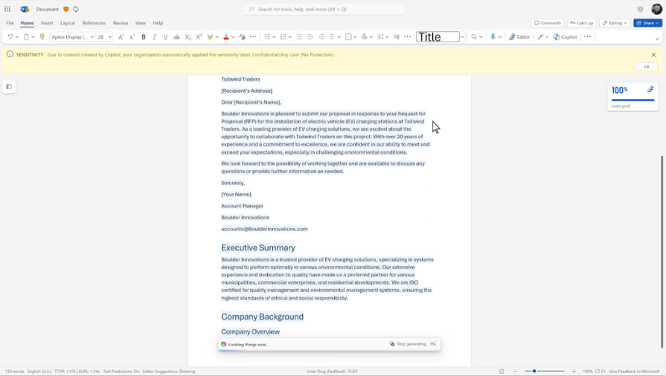
Copilot in Word
On top of Word documents, PowerPoints, PDFs and encrypted documents, Copilot can now reference emails, meetings, and colleagues when drafting content in Word. You can also jumpstart your creative process with on-canvas suggested prompts and partner with Copilot to iterate on subsections of your document to get it to a polished state.
Notes:
When working in Microsoft Word, you often need to bring in content from other documents and apps. But searching for, and incorporating, the information you need can be time-consuming and disrupt your writing. Available in October 2024, Copilot in Word will enable you to quickly reference not only web data and work data like Word, PowerPoint, PDFs, and encrypted documents but also emails and meetings. And it integrates this information right in the flow of your work, so you can get to a good first draft fast. We’ve improved Copilot in Word to be an even better writing partner. Recent updates include a new, on-canvas start experience with suggested prompts to jumpstart your creative process and the ability to collaborate with Copilot inline as you work on specific sections of your document—both generally available.

Slide 4
Draft and insert content
Copilot generates content for a new or existing Word document that can be grounded by reference documents
Notes:
With Draft, users can kick-start content generation in a formatted and structured way, draft content to insert into an existing document, or modify selected content with a prompt. Using content grounding, users can select Word, PowerPoint, PDFs, meeting transcripts and emails to use as a reference for drafting content.

Slide 5
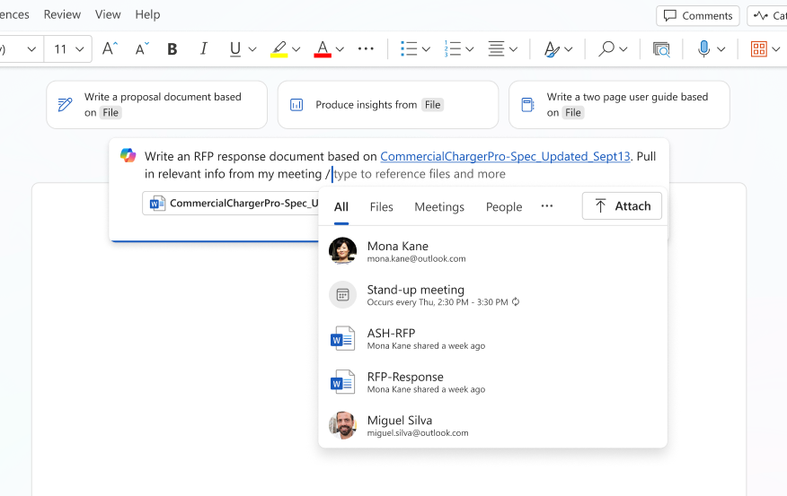
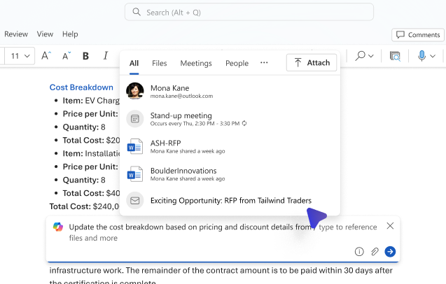
Start from a blank document and referencing emails and meetings
Tip: If you can’t remember the name of the content you want to reference, you can open the cloud file browser if using Copilot on the web to browse for the file directly.
Notes:
When you open a new blank document, Copilot now supports a more visible Draft entry point above the document, with example prompts, to help you get started quickly. In the Draft prompt input, you can now attach up to 10 files to use as a reference for Copilot, including Word, PowerPoint, PDFs, meeting transcripts and emails. The size limit for attached files has also expanded to ~75k words across these attached references, and the prompt character limit has been effectively removed. All these changes are designed to support you with the richness of content referencing and prompt development you need to craft useful and effective prompts.
Note that the ability to reference meetings will only reference the meeting transcript, not the chat threads or added attachments.
A note on the ability for Word Copilot to support grounding on pasted URLs. While Word can already ground responses from external web URLs in the Chat pane, or for document URLs saved in OneDrive or SharePoint in the Draft prompt in the document canvas, support to include other generic website URLs for grounding responses when working with the Canvas experiences like Draft with Copilot is not yet available. This is expected on Web by end-of year, and early in 2025 for the Desktop apps.

Slide 6
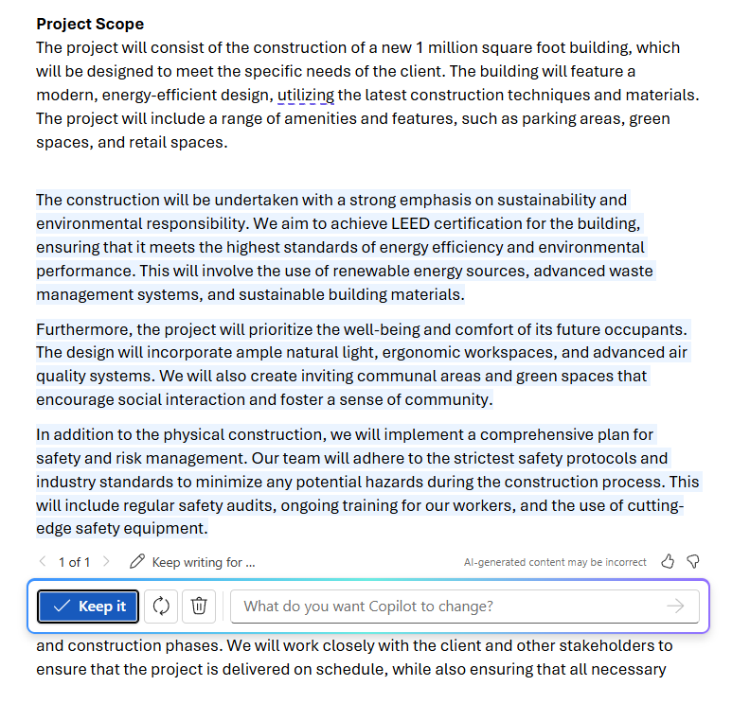
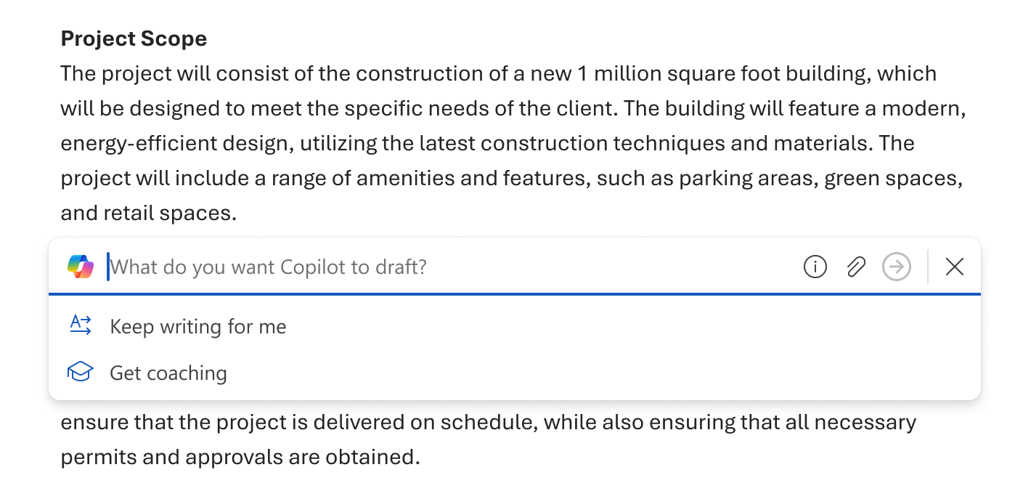

Add to and expand on existing content
Notes:
Draft with Copilot in the document canvas supports adding new text in a newline between existing paragraphs of content. A user prompt field with the ability to attach supported references, or quick actions, enable easy content creation within an existing document.

Slide 7
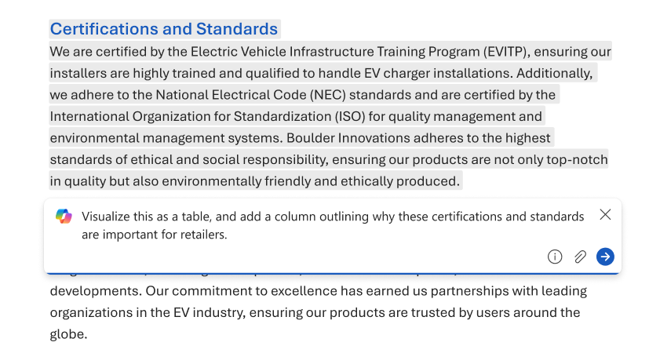
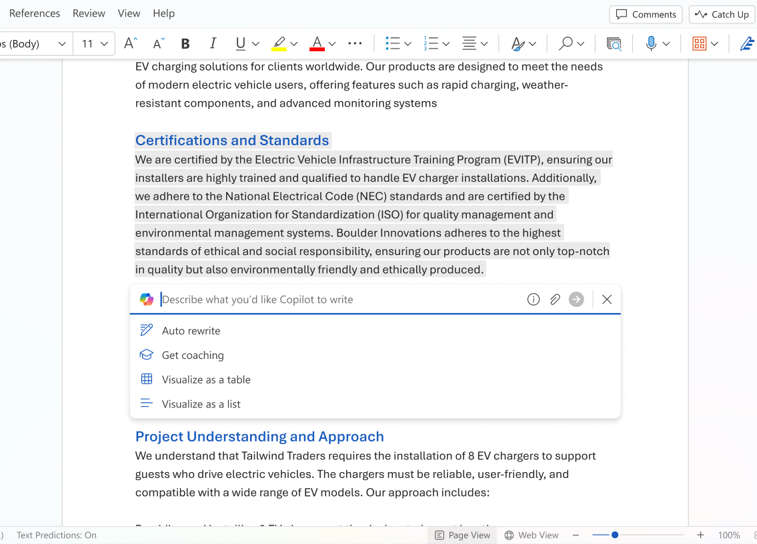
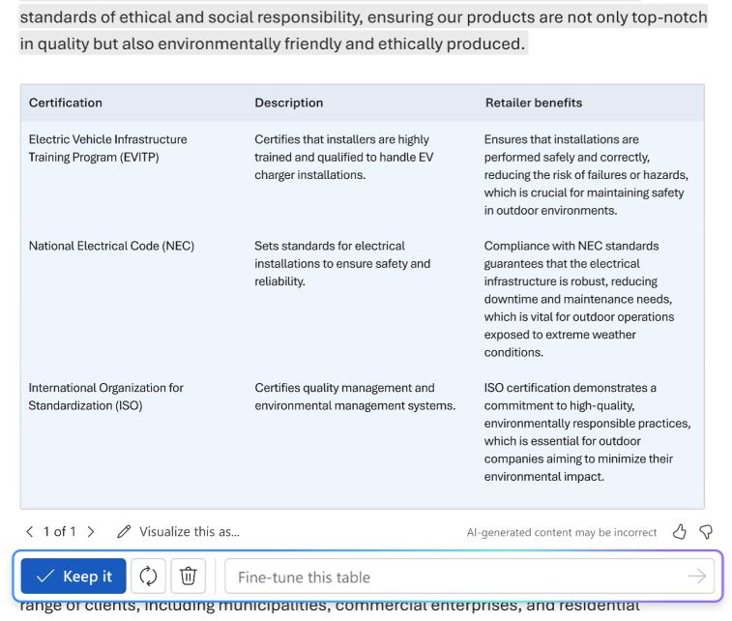
Draft from selected content
Revamp and refine selected text using Draft with Copilot in Word
Notes:
It’s often easier to reference or build on existing content. That’s why we’ve added the ability to Draft with Copilot in Word based on selected text in your document.
You can use this feature to:
Refine or rewrite existing copy.
Explain or expand on the selected content in more detail.
Enhance the content with statistics or other additional information.
Simply highlight the portion of your document that you want to refine, click the Copilot icon that appears beside the highlighted text, and in the Draft with Copilot text box, type a prompt that describes the changes you want to make, then select the Generate button. After Copilot has generated the new content, you can choose to keep it, discard it, or regenerate a different version.
At present this select text drafting support does not allow for attaching file or content references as additional grounding (as is already possible using Draft with Copilot with a blank document or new line), though that support is coming soon. e are also exploring additional functionality, such as preserving the formatting of the originally selected content or directing Copilot to apply formatting to newly generated content.

Slide 8
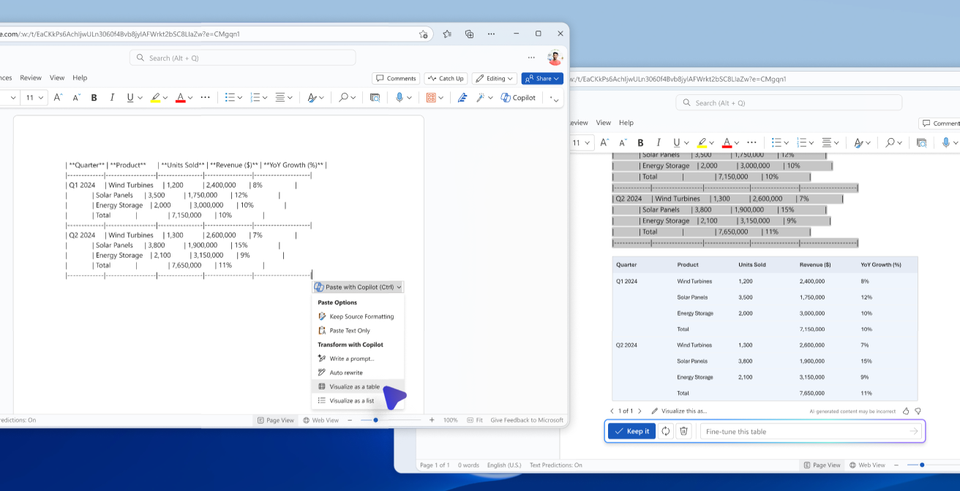
Use Copilot to polish pasted content
Notes:
Copilot is now also integrated into the paste menu in Word, so that the next time you paste content into a document that loses formatting or structure, you can now use Copilot to help add structure and formatting using either prompts or quick actions. This is available on the Web and coming soon to the desktop applications.

Slide 9
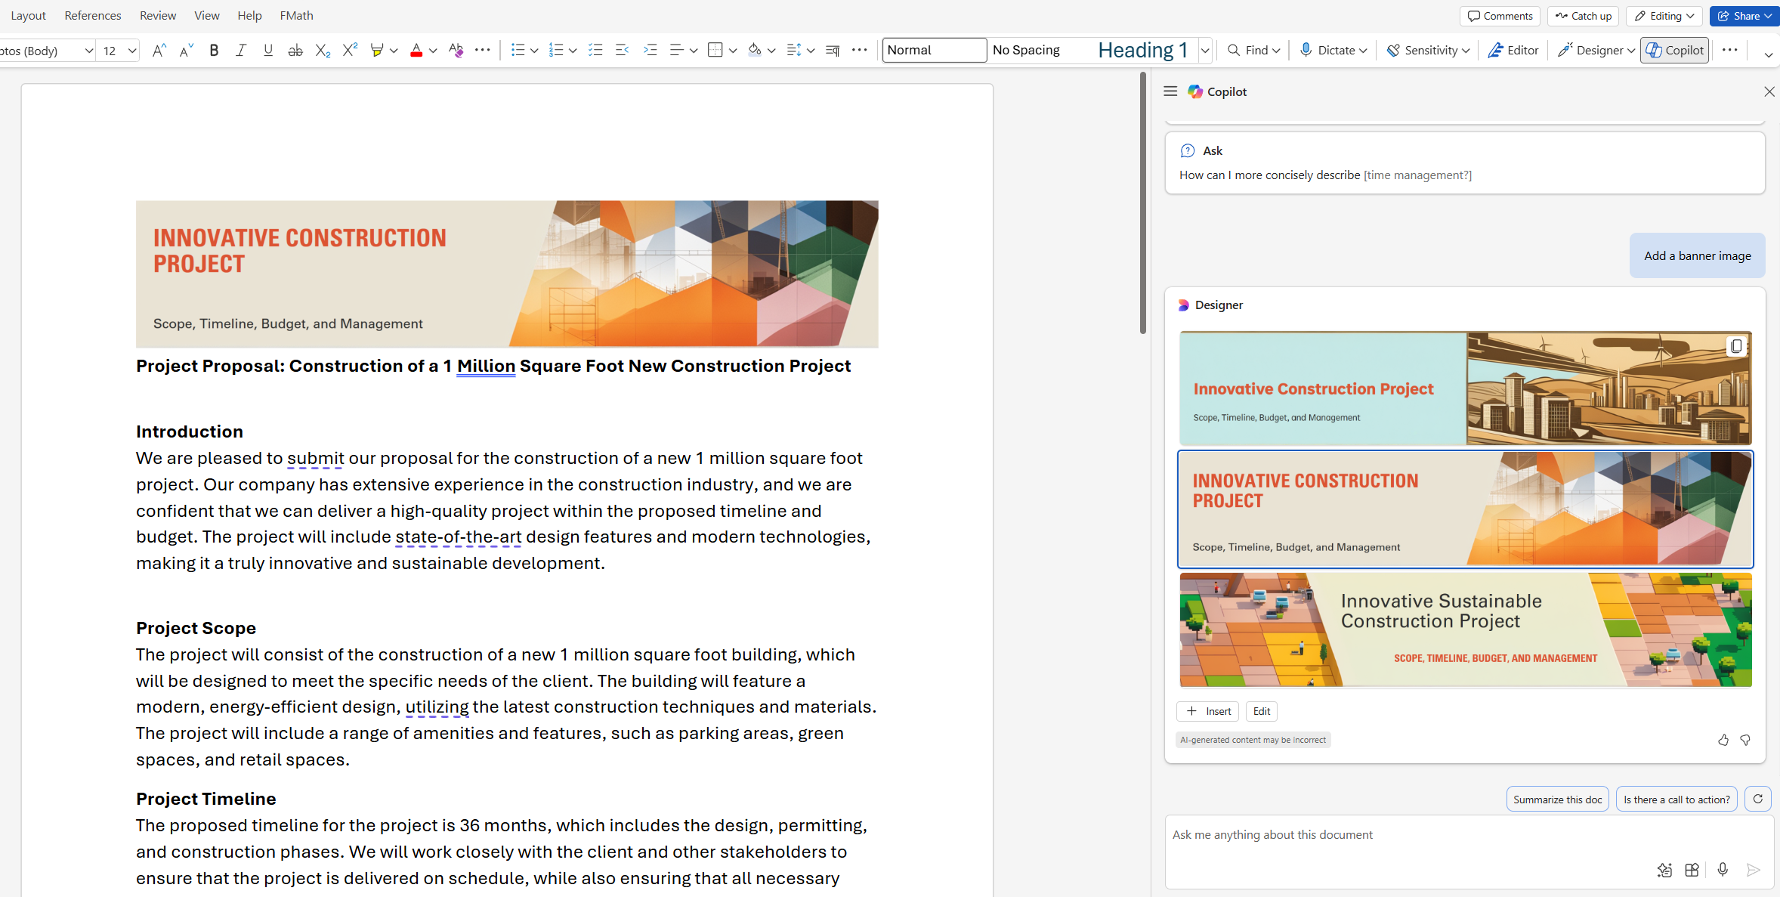
Polish your document with Designer-generated banners
Tip: Easily make edits to the generated images or text by selecting Edit, before inserting the images into the document.
Notes:
In the Chat pane, Designer integration with Word Copilot now allows you to request banners for your documents, and Designer will generate customer banner visuals tailored to your document content that you can insert into the document. This is available across all platforms.

Slide 10
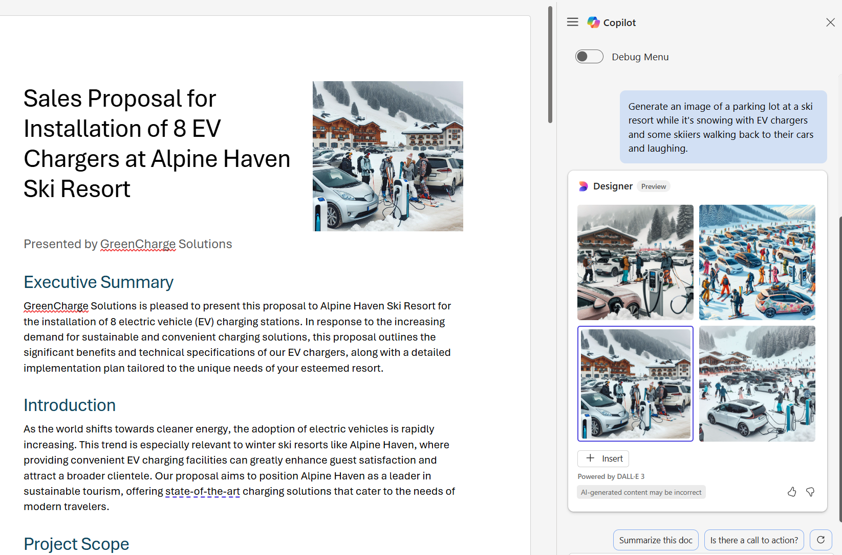
Add stock images or generate new images to add to your document
Tip: Generated images via Designer automatically insert with AltText!
Add an image or banner with Copilot in Word - Microsoft Support
Notes:
Designer support in Chat also allows you to request custom DALL-E 3 created images from a user prompt to insert into your document. Additionally, though not shown here, you can also request images from stock images, or your organizations asset library if configured, and Copilot will find and retrieve those most relevant image assets to insert into your document.

Slide 11
Rewrite content
Copilot rewrites content in many variations to suit preferred wording and tone in Word
Notes:
Copilot enables users to Rewrite Content. Users can select a paragraph and choose to rewrite it numerous times to suit their style or tone.

Slide 12
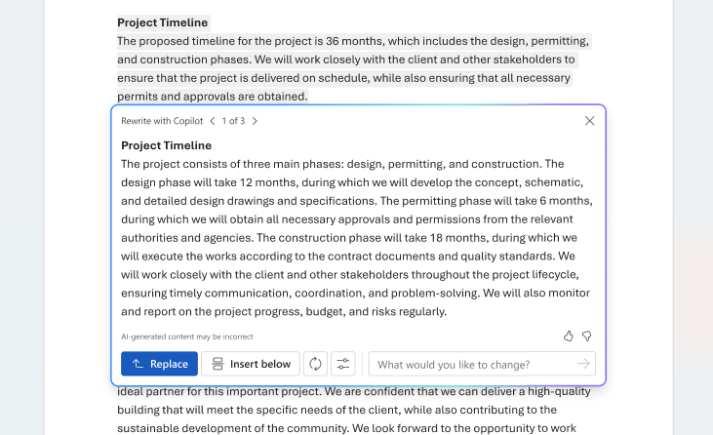
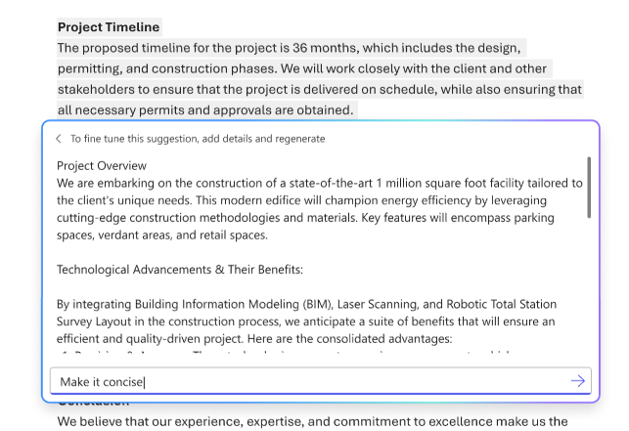
Rewrite content and refine with prompts
Tip: Refine the rewritten content using the fine-tune prompt field to suit your need and scenario.
Notes:
Rewrite support in Copilot is a high value quick action on selected text that you can use to get quick options for ways to rewrite content in different tones and styles to be more effective and impactful. Additional support for a prompt field allows you to request more specific rewrite options.

Slide 13
Visualize text as tables
Copilot transforms text content into other formats in Word
Notes:
Copilot transforms text content into other formats in Word, starting with support to visualize text as tables.

Slide 14
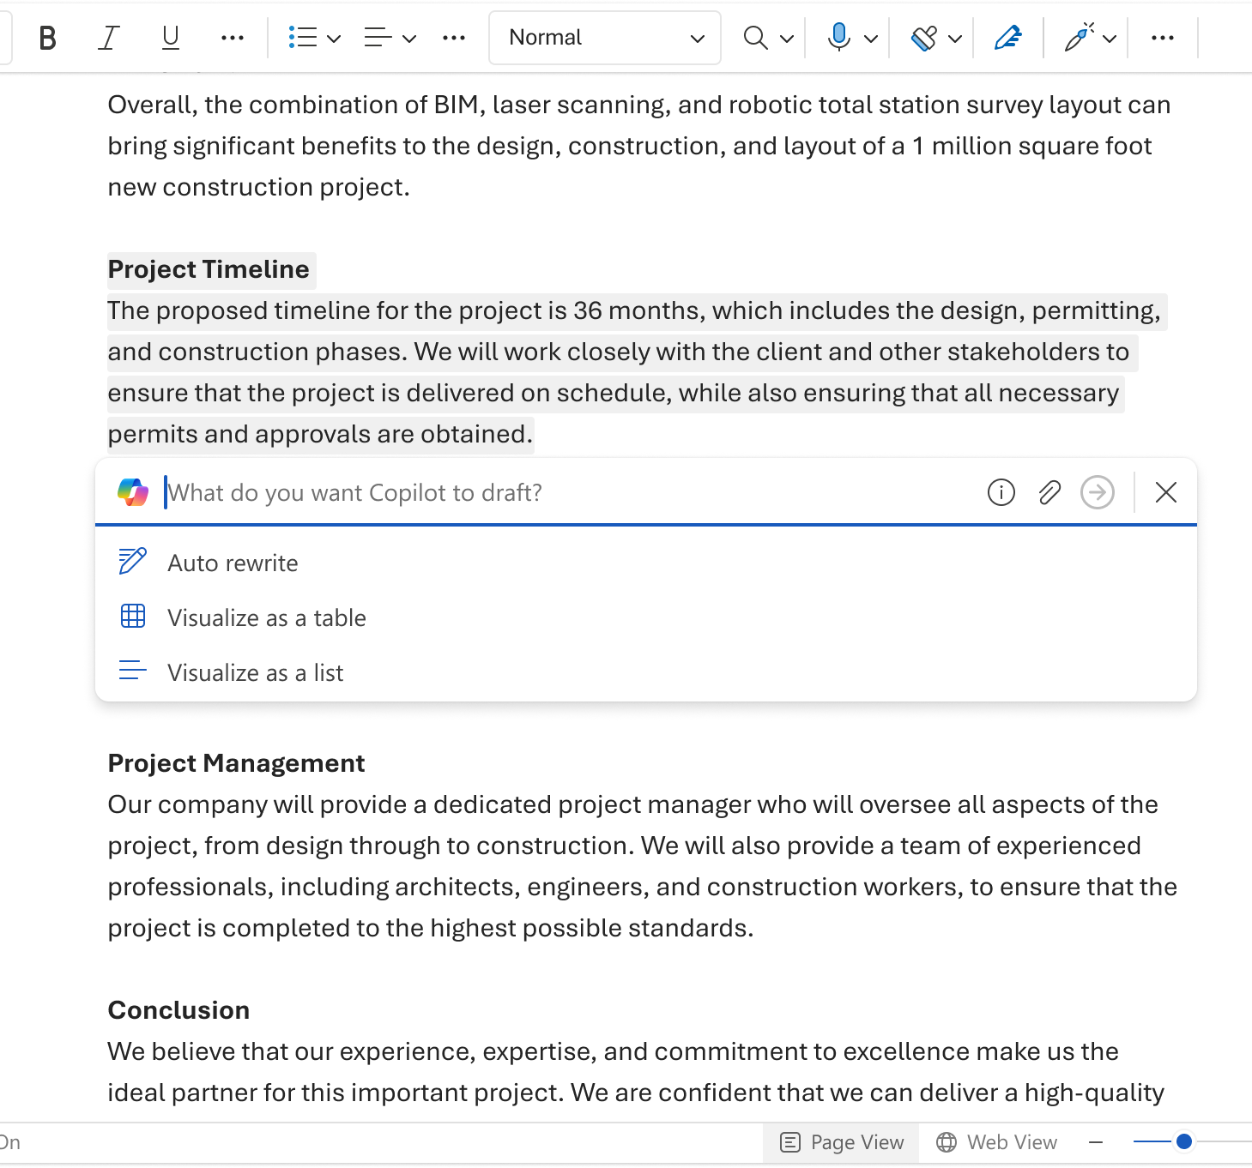
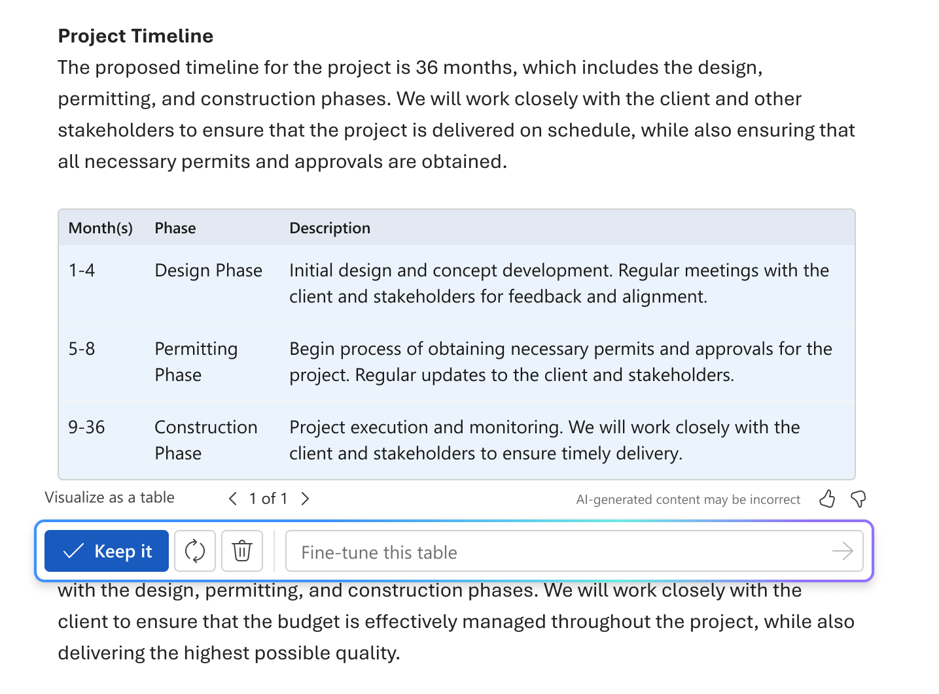
Visualize text as a table
Notes:
To use Copilot to visualize text as a table, select the text you want Copilot to turn into a table, in the left margin next to your text, select the Copilot icon, and select Visualize as a Table. Copilot will show you what the table will look like and to fine tune the table, enter details into the Copilot compose box to state what to change about the table, like "Add an empty third column."​​​​​​​​​​​

Slide 15
Get coaching
Copilot provides suggestions on high impact ways to improve your writing
Notes:
Coaching with Copilot is a new Copilot capability in Word to support you as you review content for improvements that go beyond grammar and spelling—helping you clarify ideas and giving you suggestions to increase the impact of your writing with additions, organization, style and tone, supporting information, and more. Coaching with Copilot helps you review and rewrite your content so that it is clearer and more effective, to better engage your audience and to give you confidence that your writing reflects your best work.

Slide 16
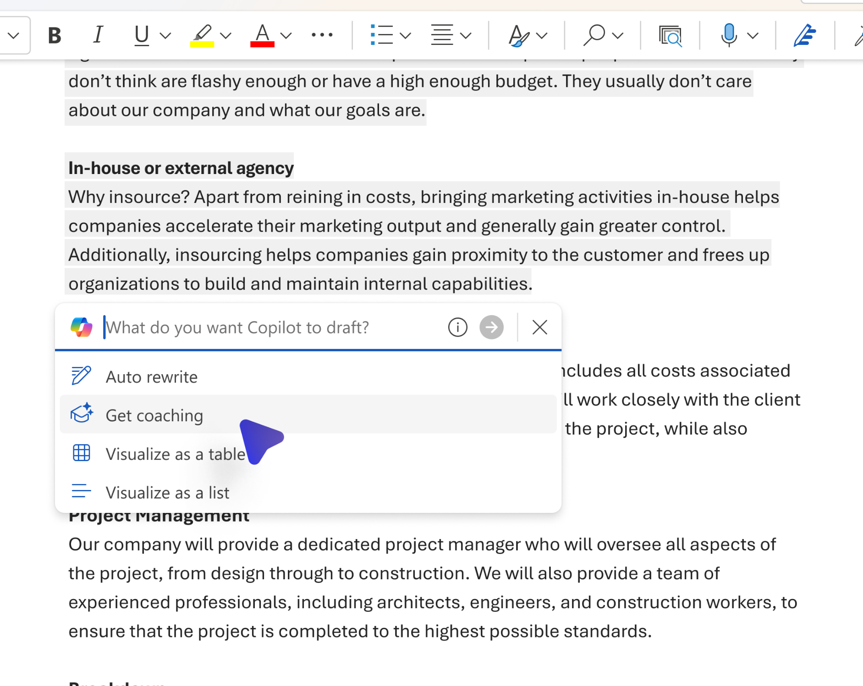
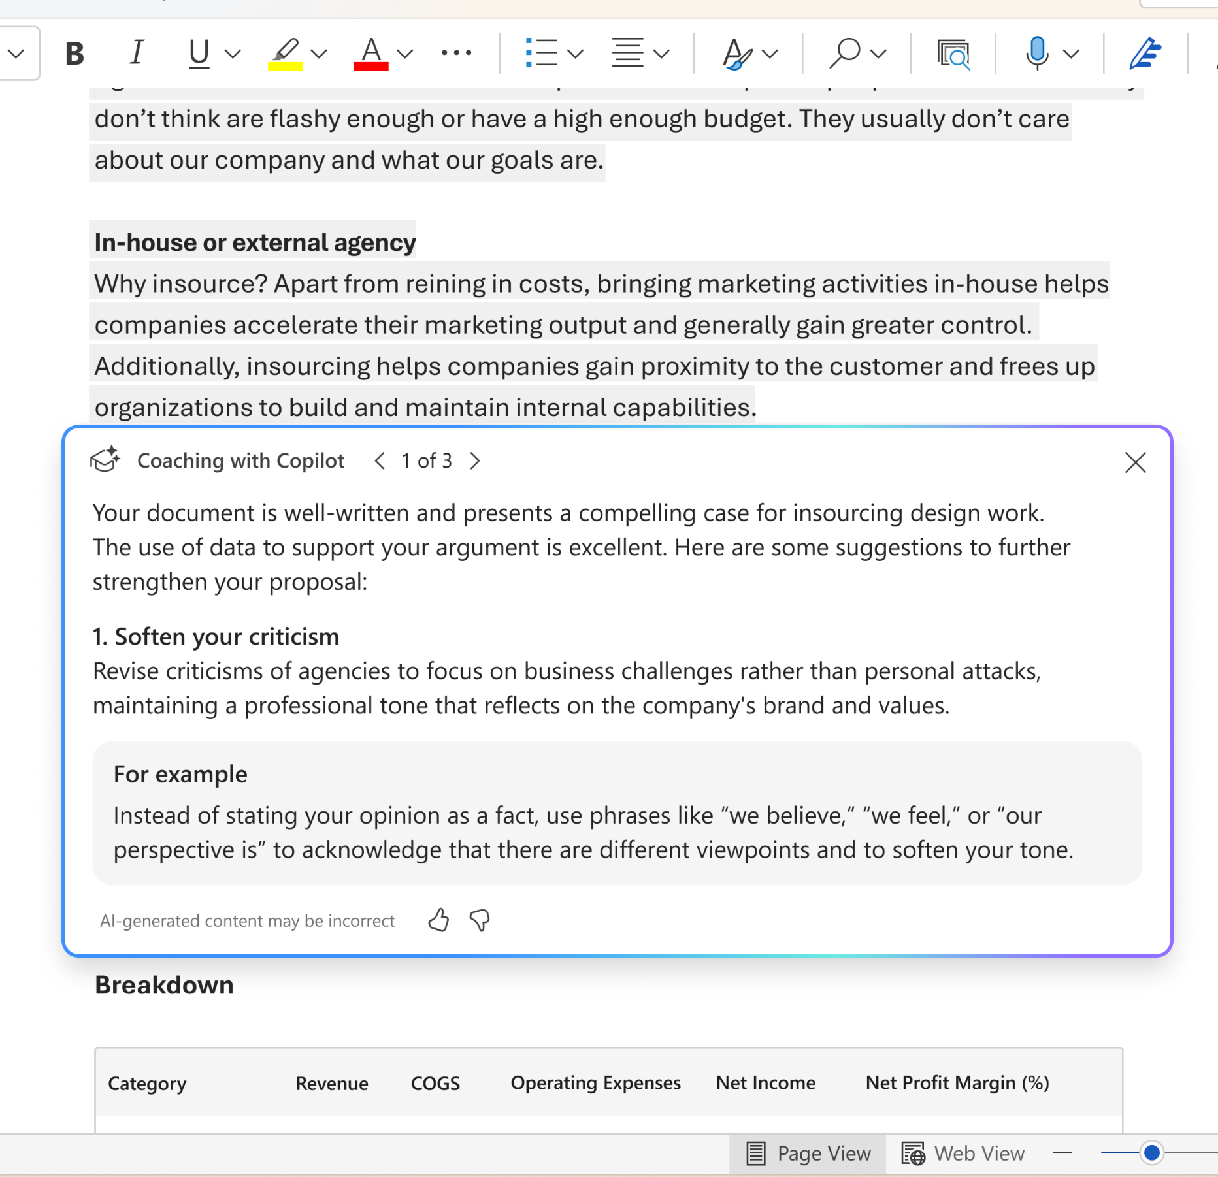
Get coaching suggestions on selected text
Tip: View additional suggestions by selecting next to navigate through the suggestion carousel
Tip: Select text you want to copy from the Coach output and make changes directly in your document – the dialog won’t dismiss while you make edits to your content.
Get Coaching
Notes:
It's quick and easy to get feedback, and you can choose whether Copilot reviews your entire document, or just a highlighted section. Maybe you wrote a strong explanation, but it feels like something might be missing. You can highlight the explanation and select Get coaching. You might get a suggestion to add a call to action and you can then decide whether that's best for your audience.
Highlight a section of text or the entire document (Note: Copilot will expand your selection if you select less than the required minimum.) Select the Copilot icon in the document and select Get coaching. Use the arrows to scroll through and review the suggestions. Try copying the suggestions from Coaching and paste them into the Draft with Copilot prompt on that same selected text to see how Copilot can help you apply these suggestions to your document. While today there is no direct ability to apply these suggestions from the Coaching dialog, that is coming soon!

Slide 17
Summarize your content
Copilot can summarize Word documents into key points
Notes:
Users are able to get a summary with key points from Word documents via chat prompts in Copilot, or on opening an existing document will now see an automatic summary generated above the document canvas.

Slide 18
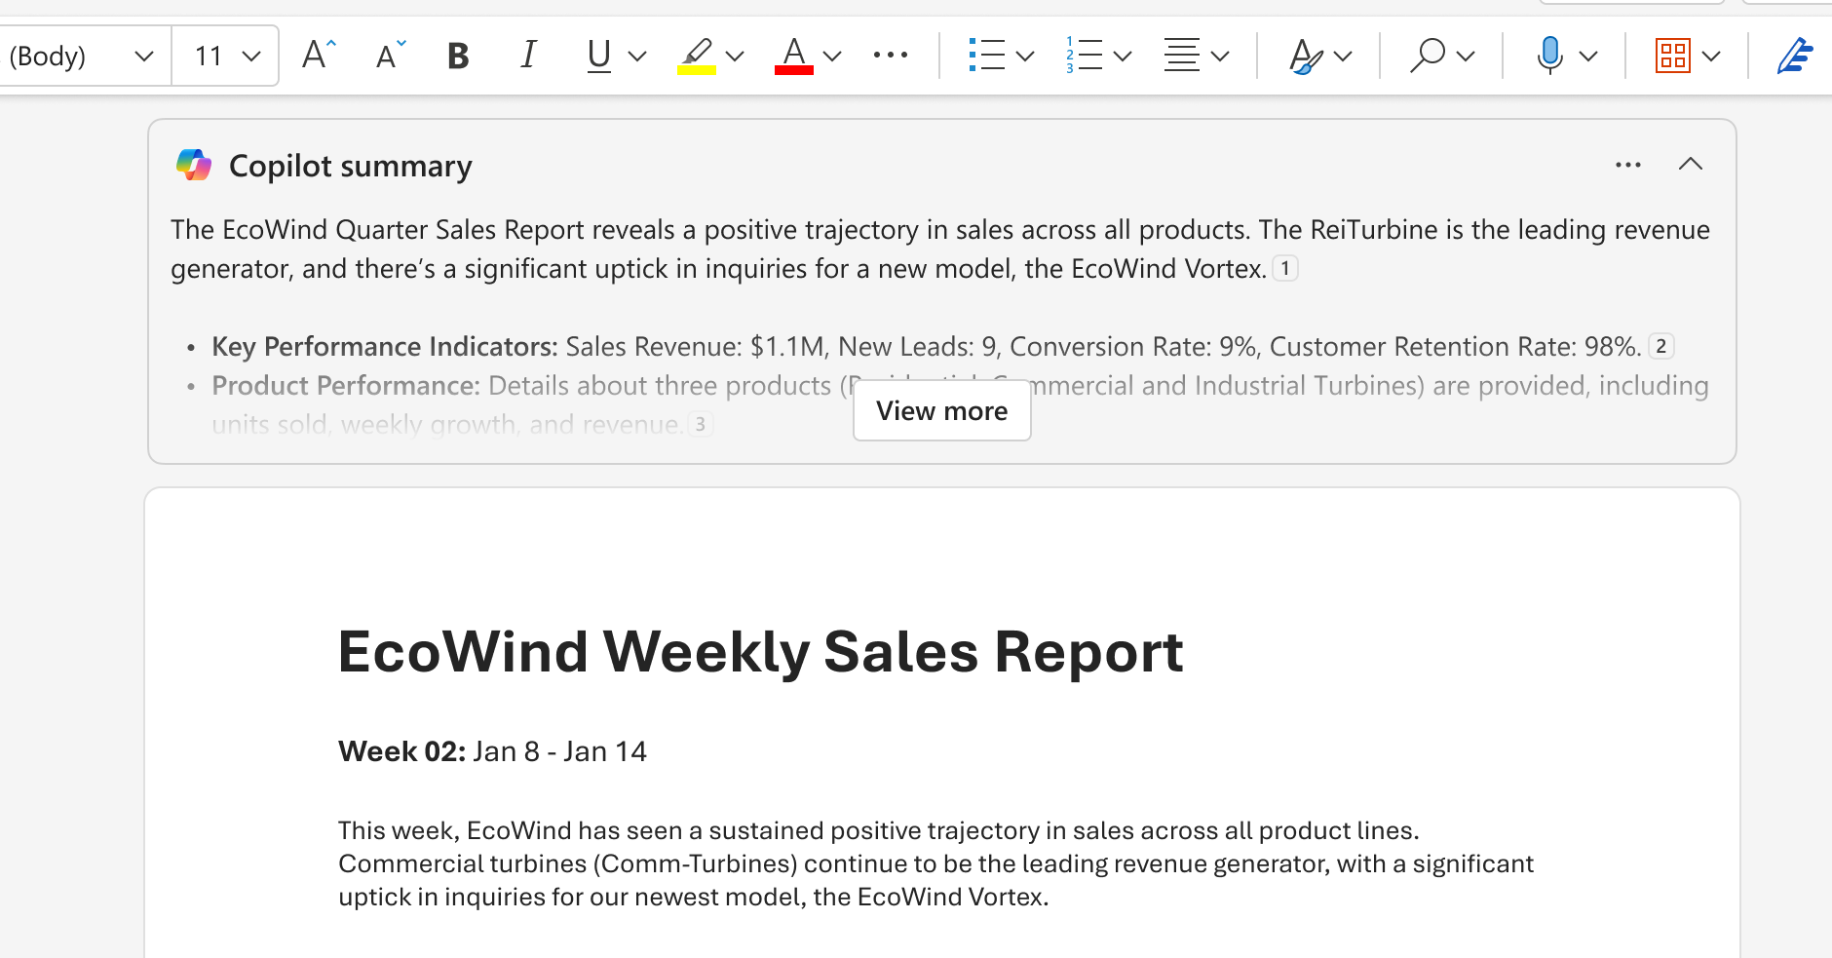
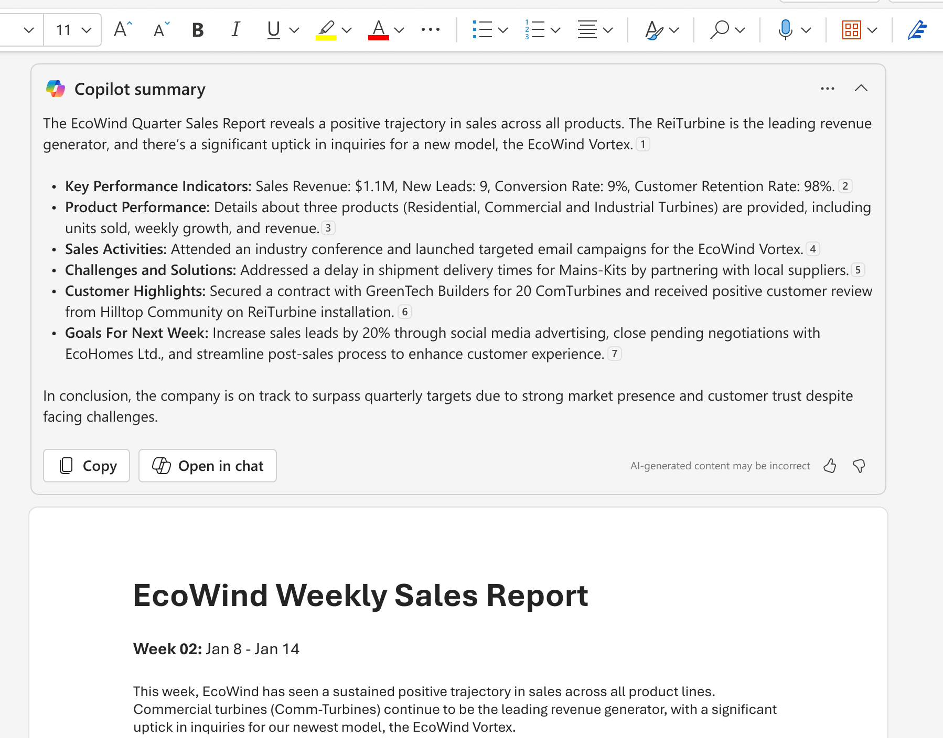
View and use the automatic summary
Tip: Select Open in Chat to continue to work with the summary or ask additional questions in the Chat pane
Generate a summary
Notes:
You'll see a summary available when you open a document and you can scan it to see what topics to expect. If you're the author of a long document, you can use the summary to quickly see if the content is organized the way you want.
The summary will be in a collapsed or partially open section at the top of the page. Select View More to see the full summary, and if you want to customize it or ask follow-up questions about the documents, select Open in chat at the bottom of the summary and enter a prompt.

Slide 19
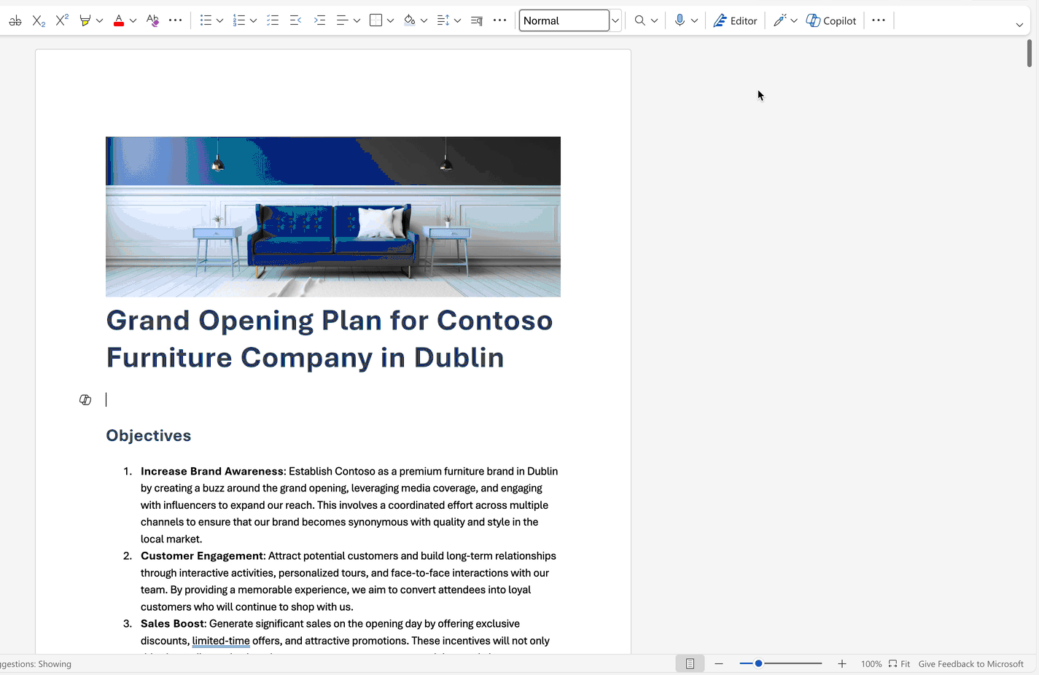
Ask Copilot for a summary or create a summary when sharing a document
Summarize Word documents with Copilot
Notes:
In addition to creating content, Copilot in Word has the ability to answer questions about the document you're reading. Once Copilot responds to your prompt, you can also view references with citations from where Copilot pulled information in your document. Go to the Copilot Chat pane and type Summarize this document into the Copilot chat pane to get a bulleted summary of the document.
For Copilot to generate summaries, the reference content needs to have at least 20 words.
Copilot is currently limited to a maximum of around 80,000 words for a single query or prompt when you're generating summaries.
Although Copilot takes the entire document into account, it currently doesn't always provide citations to later document content. We are improving this.

Slide 20
Ask questions in Chat
Copilot can answer questions about the content of the Word document
Notes:
Wondering if the document contains a meaningful call to action? Ask Copilot, and it'll attempt to tell you. Want to add some content or context to your document? Ask Copilot general questions, and it'll try to give you answers. For example:
How can I edit this document to make it sound more academic?
Is there a quote by a United States President about courage?
If those answers aren't in the document, Copilot will generate content for you using the underlying large language models. If you find something you like and want to add it to the document, just copy and paste from the Copilot pane to the document.

Slide 21
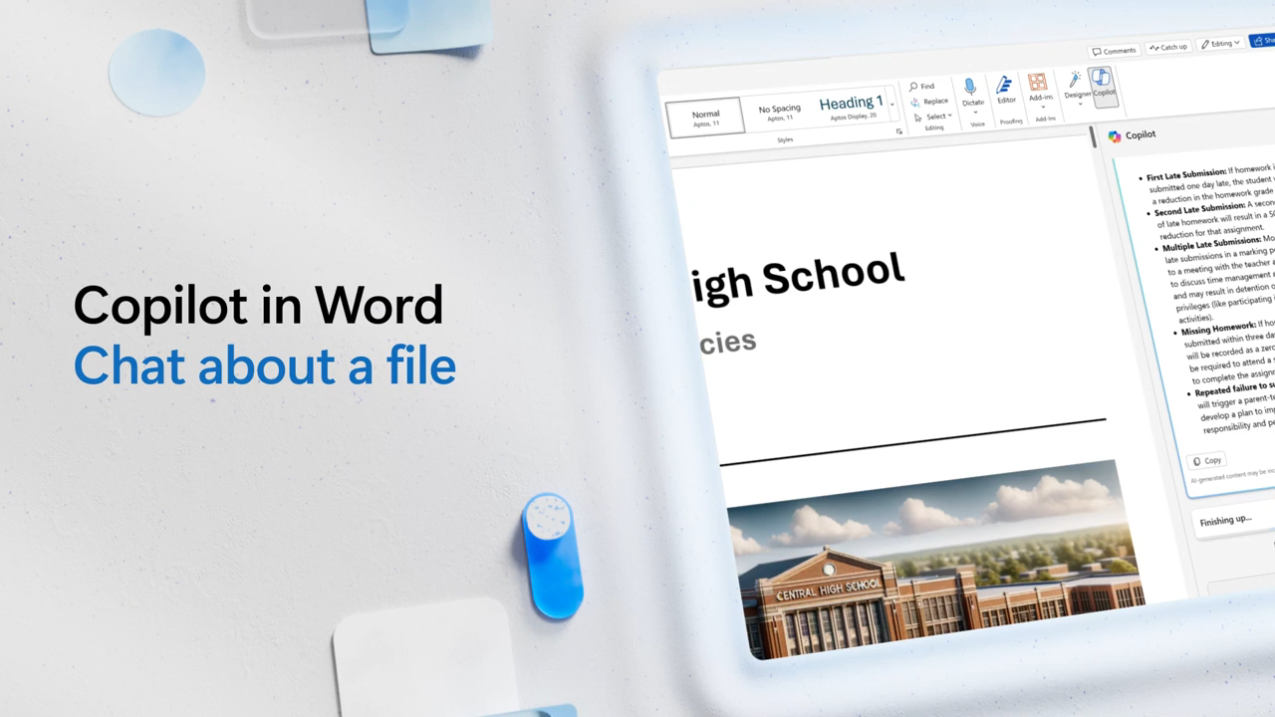
Ask questions about the document (video)

Slide 22
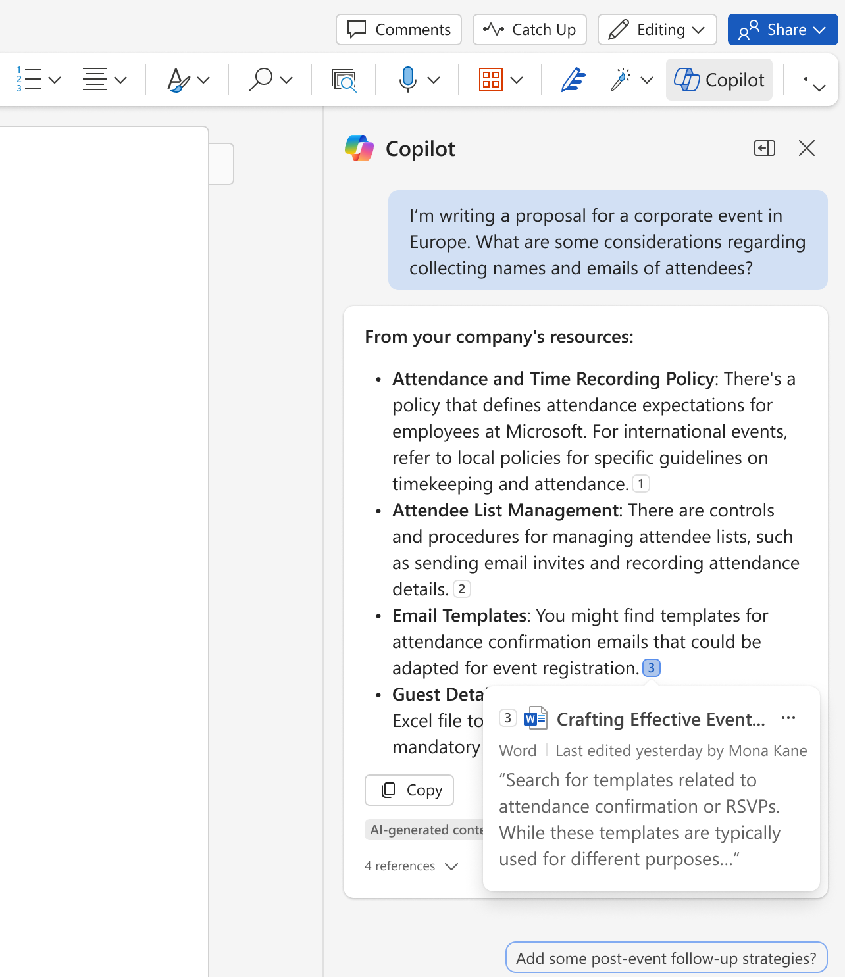
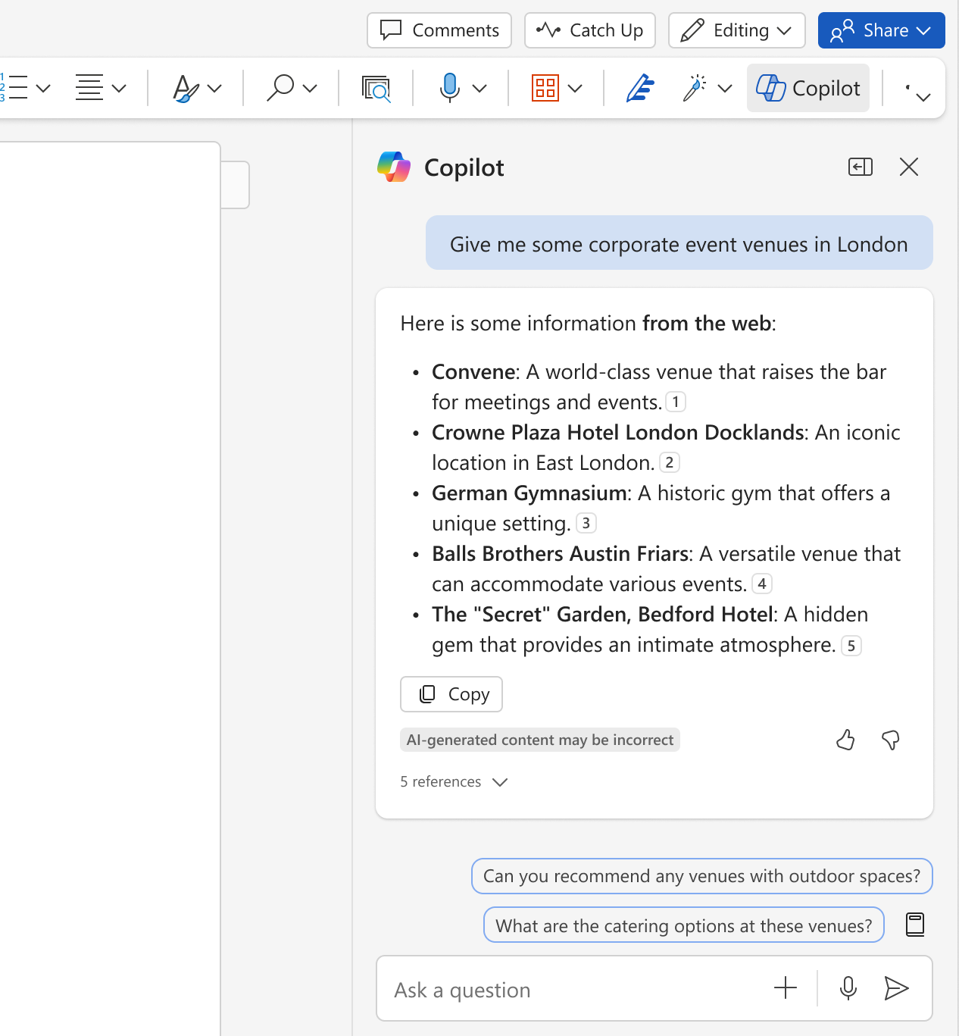
Ask open-ended questions and reference the web and work content
Notes:
In the Copilot Chat pane, you can also use Copilot to retrieve information from the web or your Microsoft 365 Graph that is relevant to a general question you ask. Copilot Chat delivers quick, relevant, and current information in a conversational format, so you don’t have to sift through multiple search results or know exactly where to find the source information you’re looking for to support a general request. Ask about specific files, messages, or general information.
Perhaps you want simple questions answered quickly, using information buried in your intranet. Try a prompt like one of these:
* What is our company vacation policy?
* What's our company policy on remote work?
Copilot Chat also looks at search results across the web to offer you a summarized response and links to its sources.
This graph and web search support is not yet available in the Draft experiences on the canvas, but support for this information retrieval from web and graph sources is coming soon. For now, attach files manually when using Draft with Copilot in the Word canvas.

Slide 23
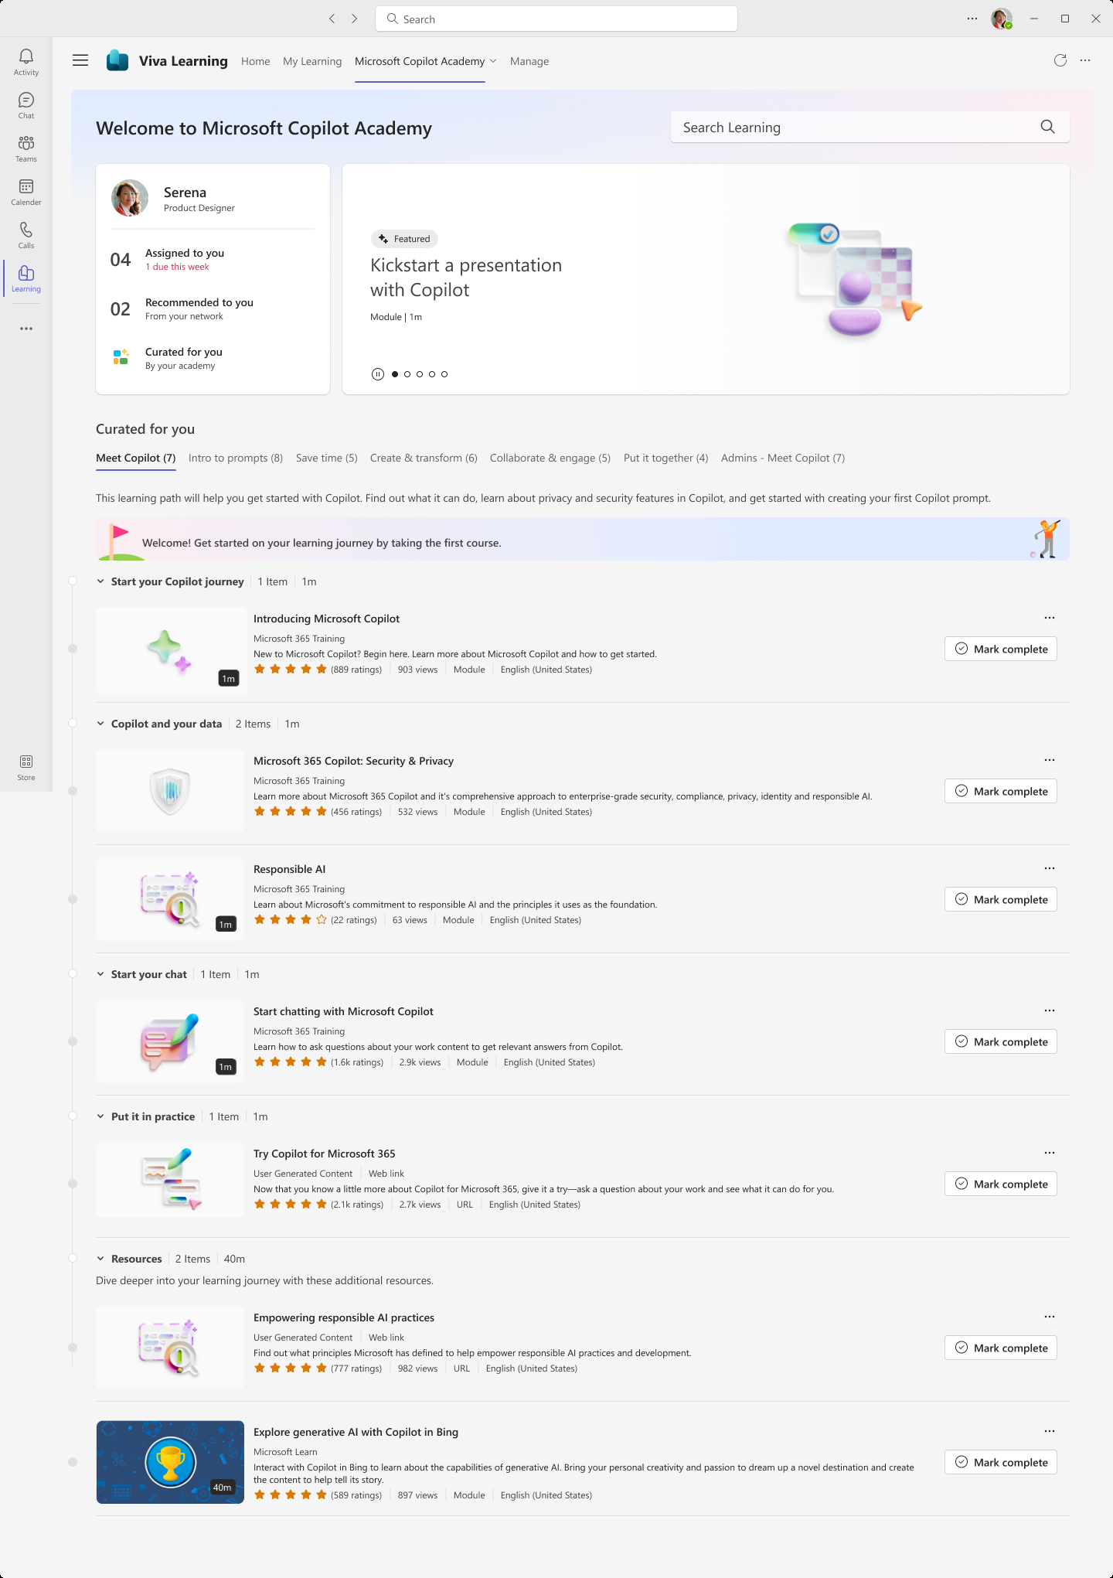
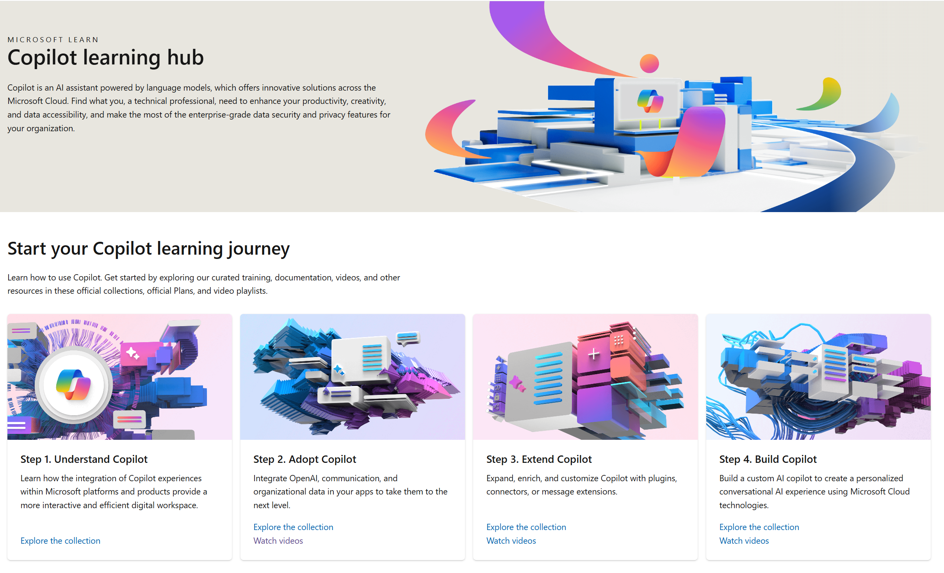
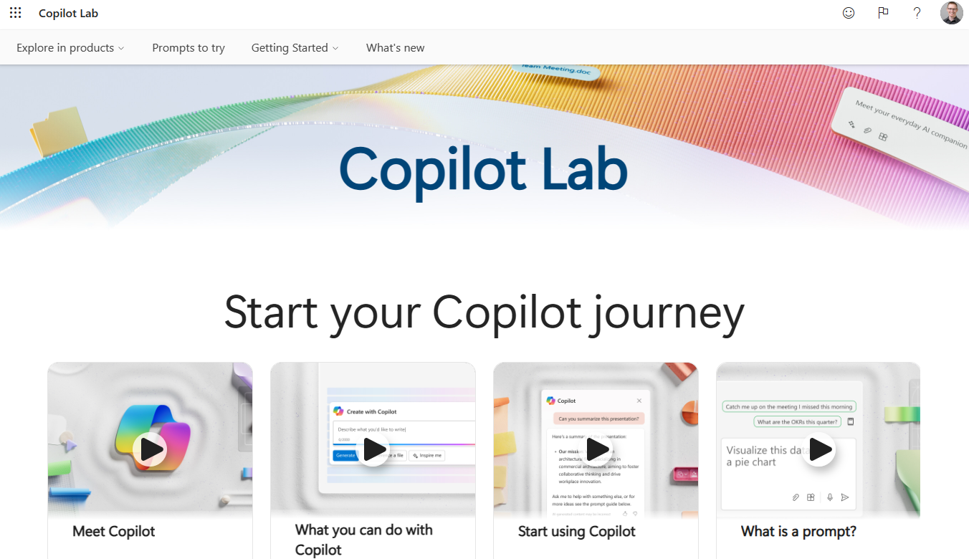
Skilling experiences
Microsoft 365 Copilot
Microsoft
Copilot Academy
Available to all Microsoft 365 Copilot customers
Centralized location to help with the basics of Copilot learning and upskilling, pulling the best content from available free Microsoft sources
Structured content in easily consumable learning paths curated
by Microsoft experts
Develop your AI interaction skills from your Viva Learning app
in Teams or webapp
Microsoft Learn
Free, on-demand training content
for skill development
Step-by-step exercises guiding learners through common Copilot prompts and use cases
Copilot Prompt Gallery
Free location to meet, learn about,
and test the capabilities of Copilot
Improve your prompt engineering skills in an interactive hands-on environment

Slide 24
Links to learn more (1 of 2)
Copilot Readiness Hub
What is Copilot?
Introducing Microsoft 365 Copilot
The Copilot System
ChatGPT vs. Microsoft 365 Copilot: What's the difference?
How Copilot works
How Microsoft 365 Copilot works: Microsoft Mechanics video
Semantic Index for Copilot
Microsoft Graph
Microsoft Graph connectors
Additional copilot experiences across the Microsoft Cloud
  Microsoft Dynamics 365 Copilot
  Copilot in Power Platform
  Microsoft Security Copilot
  GitHub Copilot
  Copilot in Microsoft Stream
Privacy
Microsoft’s privacy policy
Microsoft Privacy Statement
Trust Center data protection and privacy
Data, privacy, and security for Microsoft 365 Copilot
Data, privacy, and security for Azure OpenAI Service
Role-based access control
User permissions and permission levels in SharePoint Server
Customer Lockbox requests
Microsoft 365 isolation controls
Data Protection Addendum

Slide 25
Links to learn more (2 of 2)
Data residency and storage
EU Data Boundary
  Website
  Blog
  Documentation
Compliance
Microsoft Compliance
Service Trust Portal
Compliance offering definitions
General Dat Protection Regulation (GDPR)
  Full summary
  Short summary
Security
Configure usage rights for Azure Information Protection (AIP)
Universal Licensing Terms for Online Services
Data Protection Addendum
Isolation and Access Control in Microsoft 365
How to prepare for Microsoft 365 Copilot
Learn about Microsoft feedback for your organization
Manage Microsoft feedback for your organization
How to manage Microsoft Search
Microsoft 365 Product Terms
Content management and security in SharePoint, OneDrive, and Teams
Transcription Management in Microsoft 365 Copilot
Responsible AI
Responsible AI core principles
  Videos
  Documentation
Microsoft Responsible AI Standard
Governing AI: A Blueprint for the Future

